Slide 1
Methods and goals
METHODS:
Sampling of 240 1year old shoots (120 from own-rooted plant; and 120 from grafted ones)
2020
Biometric measures at shoot level (diameter, length, number of nodes) of 1 year old shoots (parent);
Qualitative measures at node level (type of bud/sylleptic (M= mixed, C=catkin, V=vegetative, B=blind) of the same 1 year old shoots
2021
Biometric measures at shoot level (diameter, length, number of nodes) of 1 year old shoots (child) born from the parerent;
Qualitative measures at node level (type of bud/sylleptic (M= mixed, C=catkin, V=vegetative, B=blind) of the same child shoots
GOALS:
The model of my dreams should answer those questions:
How 1 yeard old shoot is composed?
There are some zones of the same type of bud?
There are difference in composition according to the length of the shoot?
How is the behavior of lateral shoots?
How many of them developed?
Where?
From which bud? (vegetative or mixed?)
how can we deal with multiple buds and multiple lateral shoots per node?
This problems cold be solved analysing the data:
From different point of views
Shoot scale
Metamer scale
Bud scale
With different tecniques:
exploratory analysis
Glms/marcovian
WE WILL FOCUS JUST ON ON OWN-ROOTED PLANTS

Slide 2
Hazelnut architecture

Slide 3
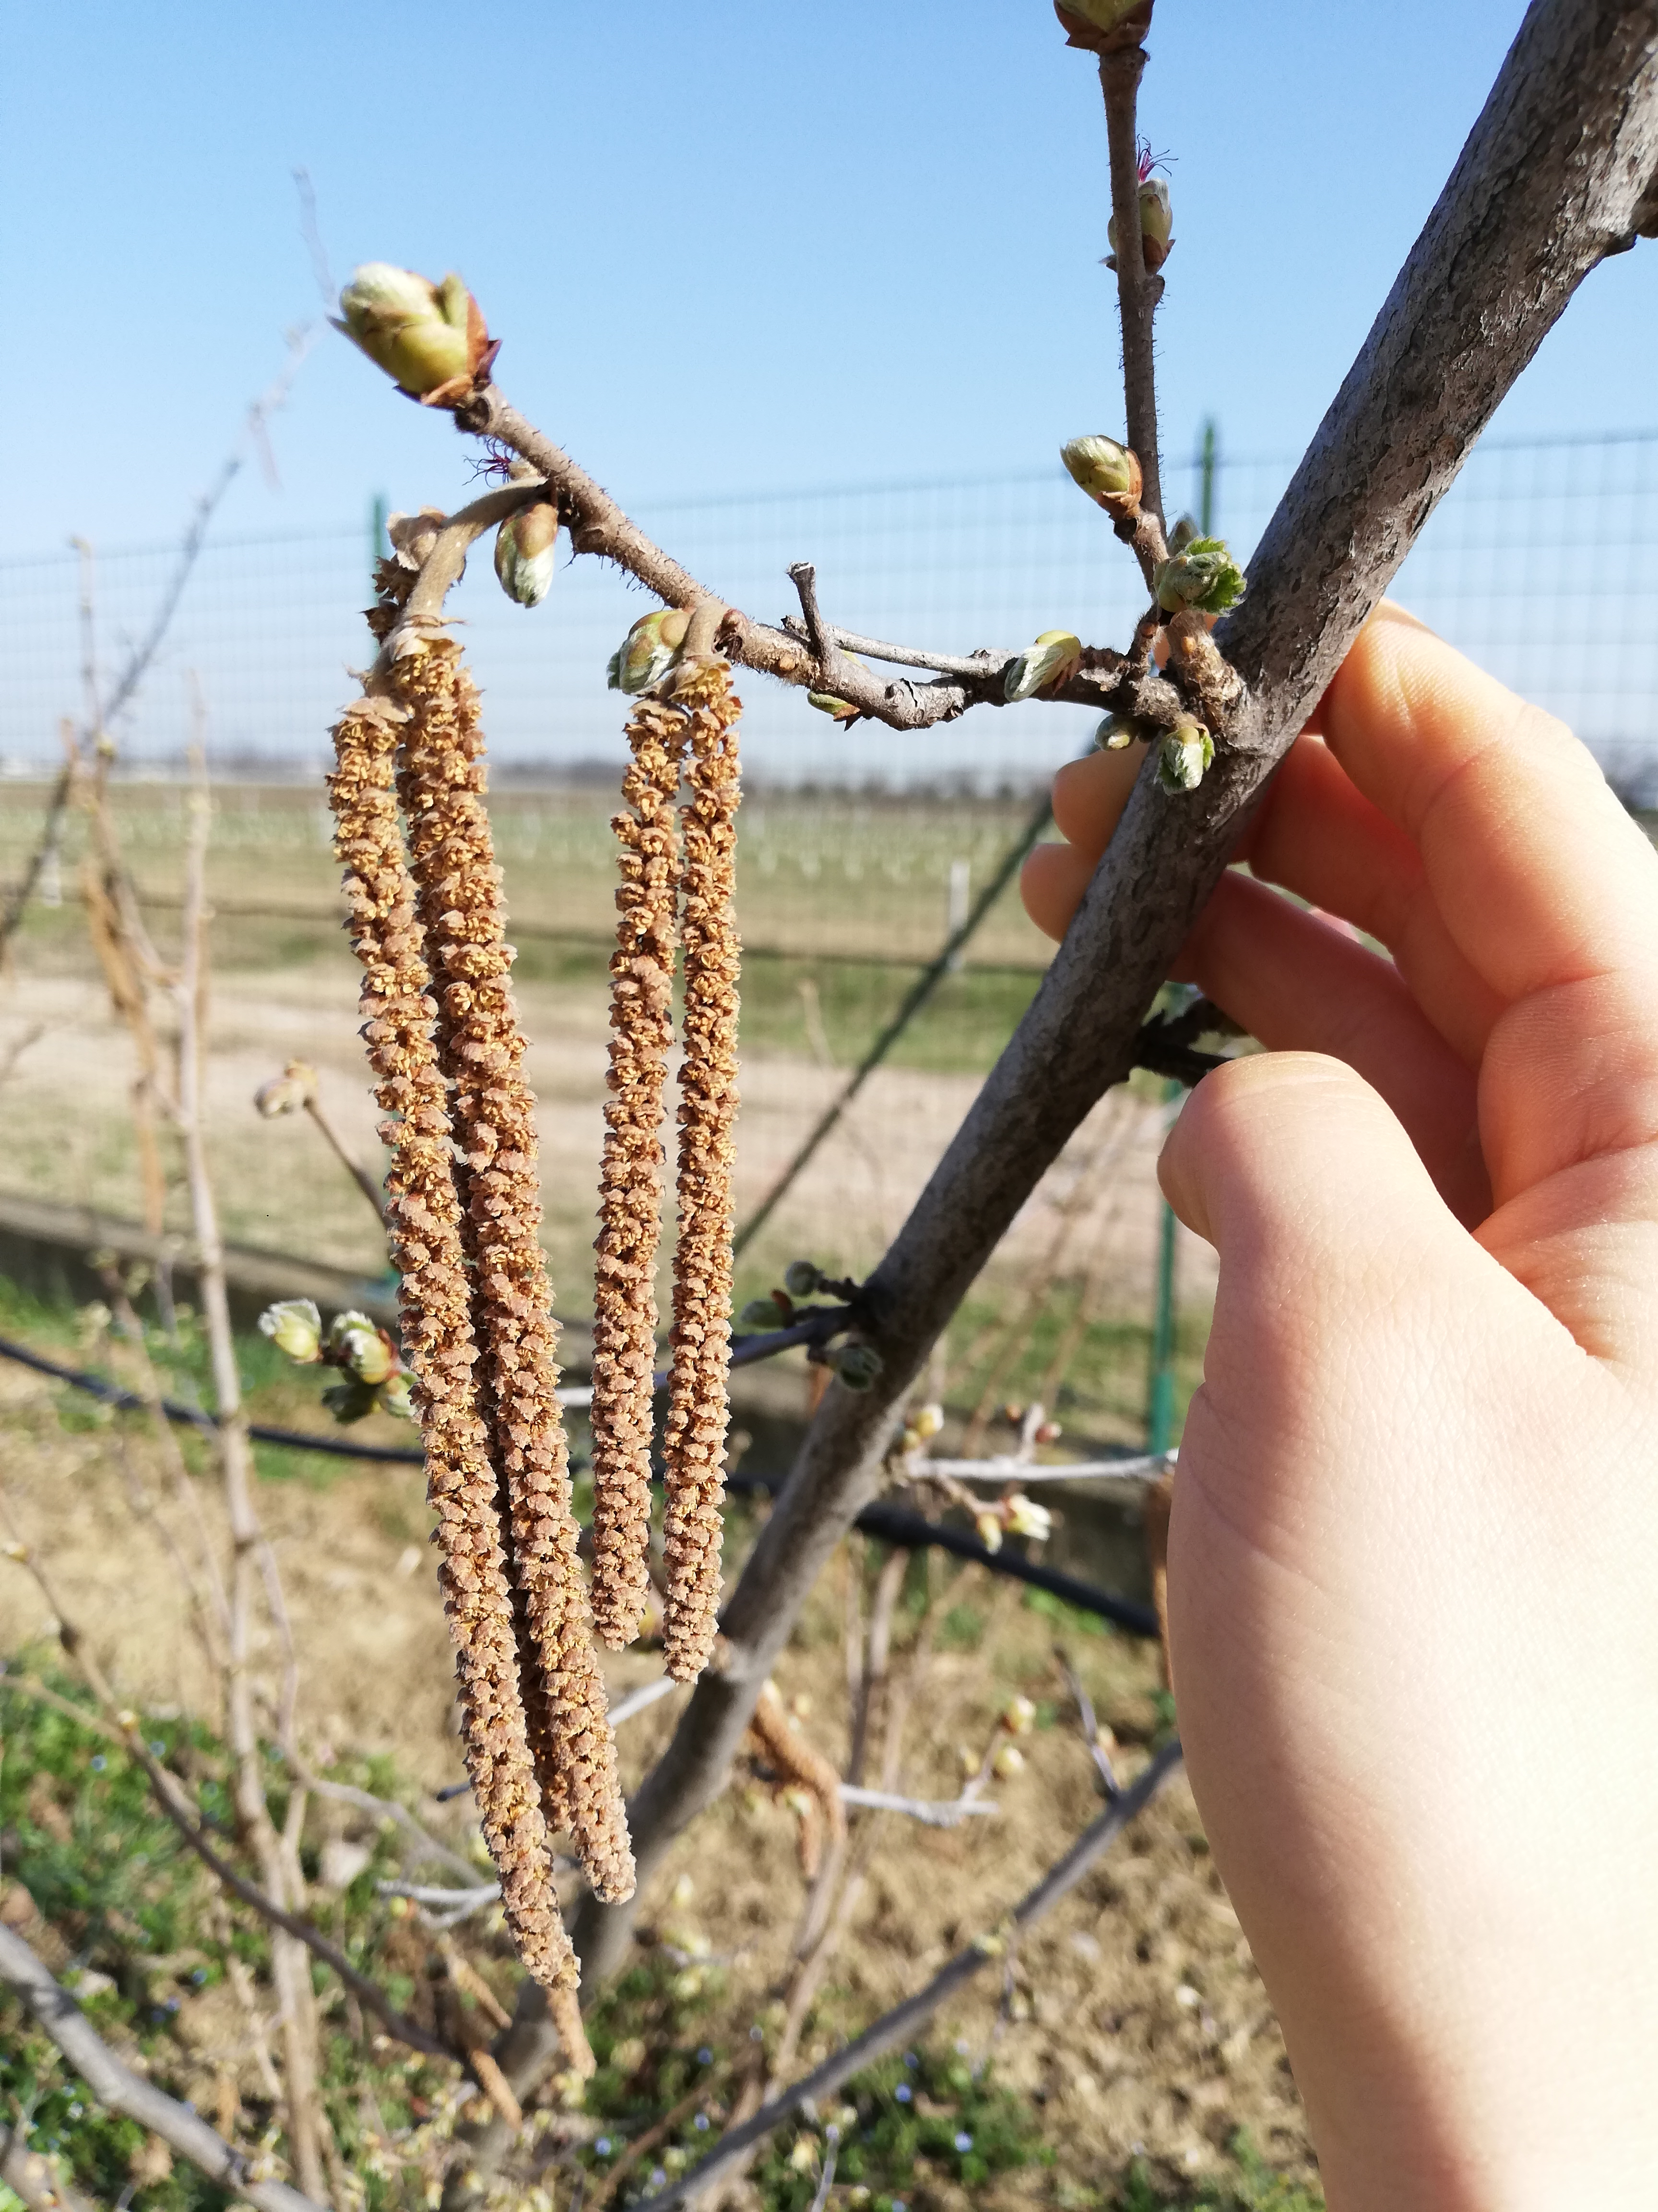
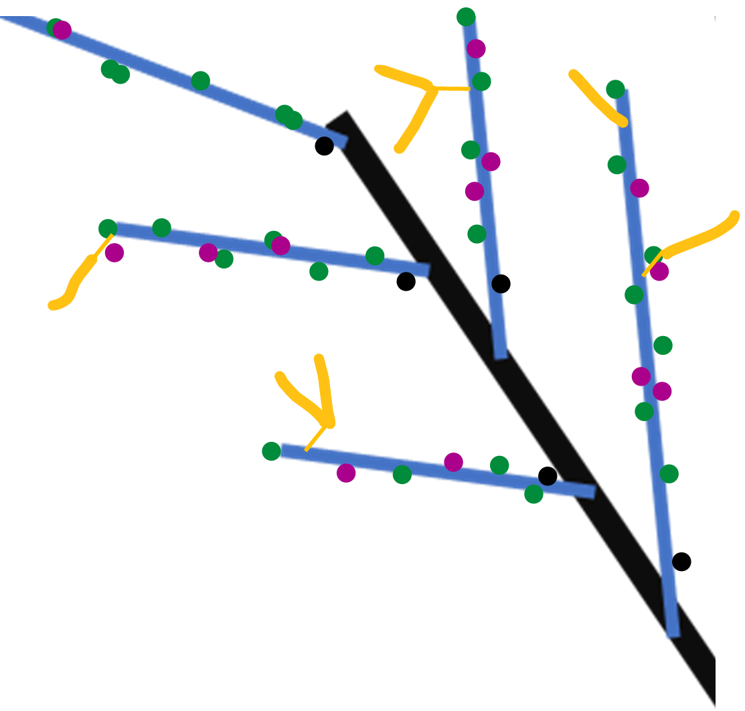
Winter observation
Year n
Year n
Proleptic shoot (referred to black)
Sylleptic shoot (referred to blue)
vegetative bud
Year n-1
Mixed bud
Blind node
catkin
SYLLEPTIC SHOOTS

Slide 4
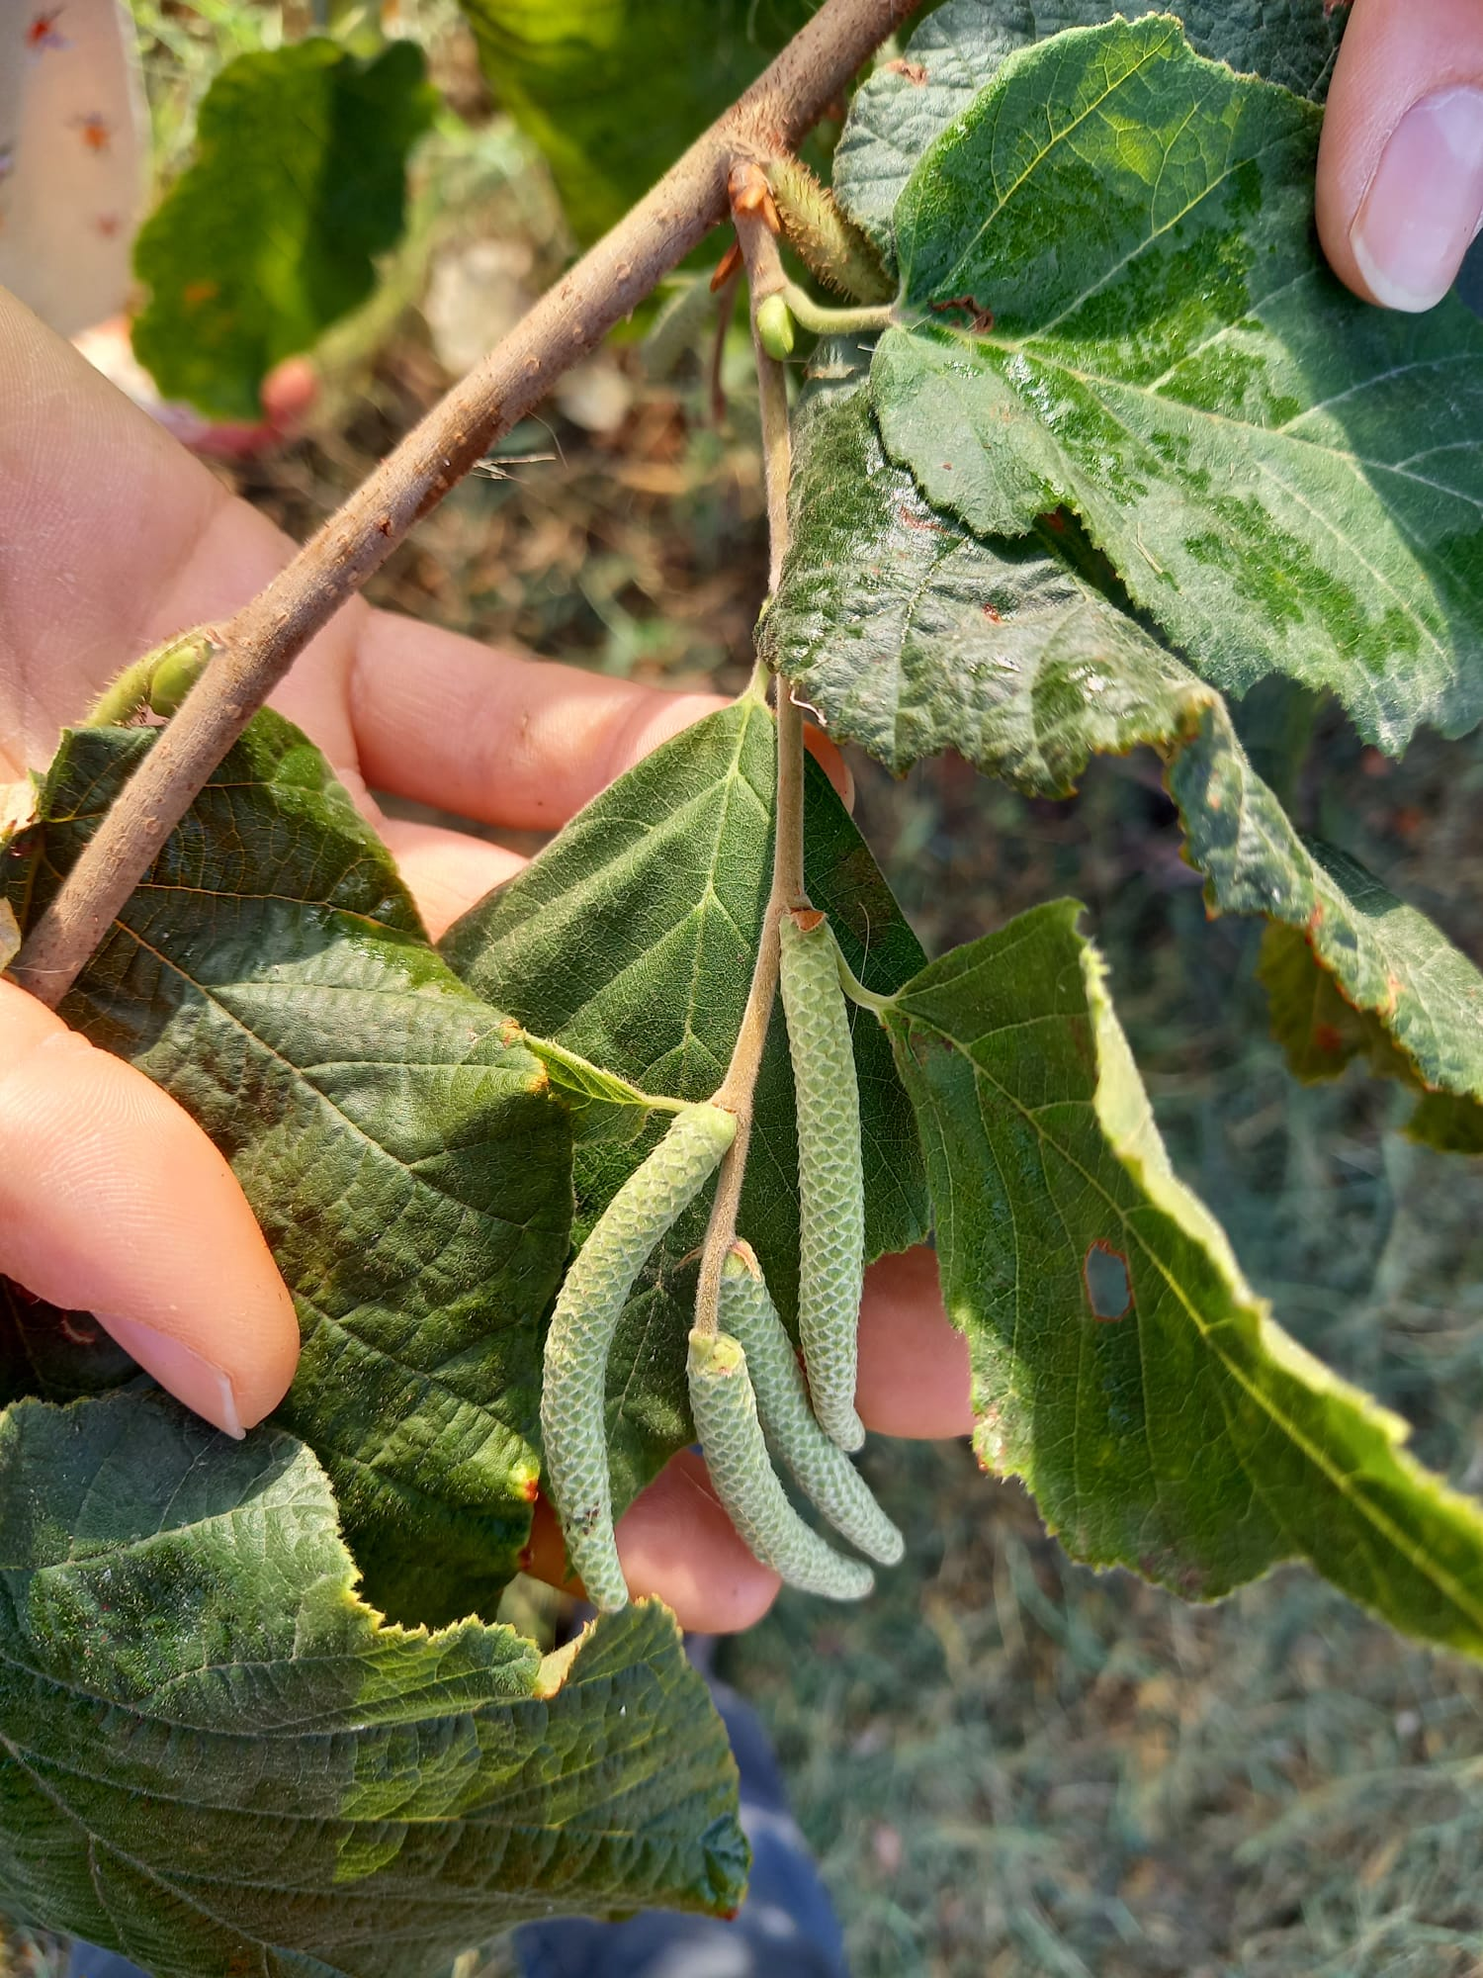
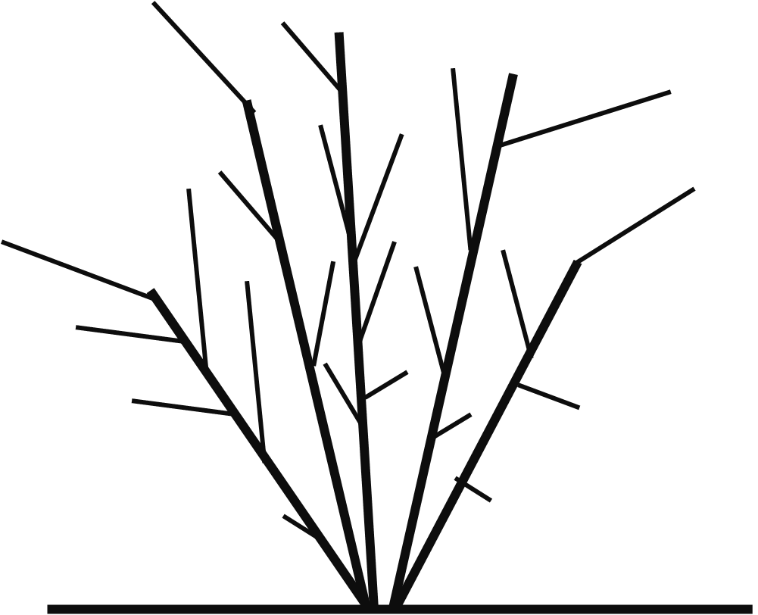
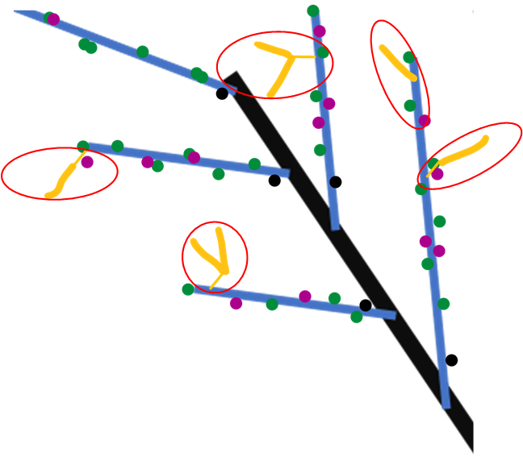

Spring growth
Year n+1
Year n+1
Year n
New proleptic shoot
Year n+1
Year n-1
New sylleptic shoot
Year n+1
leaves
SYLLEPTIC SHOOTS

Slide 5
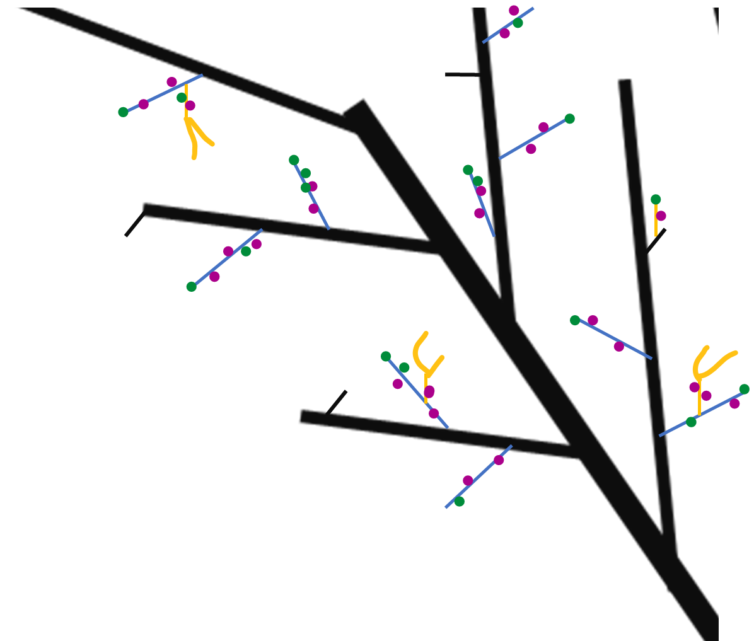
Next winter observations
Year n
Year n
Year n+1
Proleptic shoot
Year n+1
Sylleptic shoot
vegetative bud
Mixed bud
Year n-1
Blind node
catkin
SYLLEPTIC SHOOTS

Slide 6
GLMs
Markovian models
They are used to understand if a predictor describes a variable
Poisson if the variable is quantitative;
Binomial if the variable is categorical
Es. Is Vegetative bud burst (Y) depending on (~) length, rank node, sibling M, sibling V, tot buds at that rank?
They are used to understand if the variables (buds) can be grouped into homogeneus zones.
HAZELNUT ISSUES:
Dependencies between rank nodes;
Dependencies between buds at the same rank
NB_i glm sono delle generalizzazioni dei modelli lineari. Ipotizzando che le variabili possano essere distribuite anche in altri modi rispetto alla distribuzione normale

Slide 7
DATASET_ARCHITECTURE HAZELNUT
Process
OWN-ROOTED e INNE
 | Starter DF | Ending DF | What was done | Scripts | Scale
1 | 2020DFAUTO.csv | 2020shoot_level.csv | Count number of buds per each shoot; Adding the plant ID to each shoot; | create_shootlevel.R | shoot
2 | 2020shoot_level.csv | 2020metamer_level.csv | Creating the dataframe at the metamer level | create_metamer_level.R | Metamer
3 | 2020metamer_level.csv | 2020metamer_level.csv | Information of how many shoots developed next year | modify_metlevel.R | Metamer
4 | 2020shoot_level.csv | 2020shoot_level_DEVELOPED.csv | CREATE A NEW DATASET WITH THE SHOOT OF 2020 THAT WERE FOUND IN 2021 | modify_shootlevel.R | Shoot
5 | 2020metamer_level.csv | 2020metamer_level_DEVELOPED.csv | CREATE A NEW DATASET WITH THE SHOOT OF 2020 THAT WERE FOUND IN 2021 | modify_metlevel.R | Metamer
6 | 2020metamer_level_DEVELOPED.csv | bud_level_develop.csv | Duplicate the rows for the number of buds of each metamer | create_bude_level | Bud
7 | bud_level_develop.csv | bud_level_FINAL.csv | Position of the bud (lateral/apical) Fate of each bud Number of sibling buds (in multiple buds Numberof new shoots Info regarding the new shoot developed Substrating to the sibling value the fate of that bud | create_budlevelFINAL.R | Bud

Slide 8
DATASET_ARCHITECTURE HAZELNUT
Process
OWN-ROOTED
 | Starter DF | Ending DF | What was done | Scripts | Scale
8 | bud_level_FINAL.csv | bud_level_LATERALS.csv | Filter just for lateral buds | modify_budscale.R | Buds
9 | bud_level_FINAL.csv | bud_level_APICALS.csv | Filter just for apical buds | modify_budscale.R | Buds
10 | 2020metamer_level_DEVELOPED.csv | met_level_develop_lateralbuds.csv | Modifying the count of buds per each node, removing the apical bud!!! | modify_metlevel.R | Metamer
11 | 2020shoot_level_DEVELOPED.csv | 2020shoot_level_DEVELOPED_fin.csv | Adding the info of how many lateral and apical buds and the fate of apicals | modify_shootlevel.R | Shoot
12 | 2020shoot_level_DEVELOPED_fin.csv | shoot_level_develop_lateralbuds.csv | Modifying the count of buds per each node, removing the apical bud!!! | modify_shootlevel.R | Shoot

Slide 9
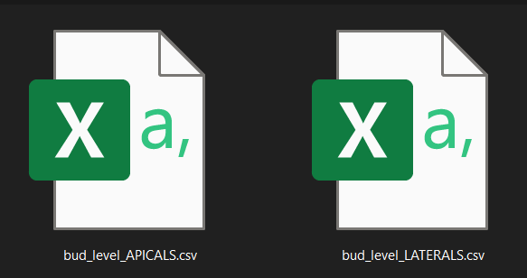
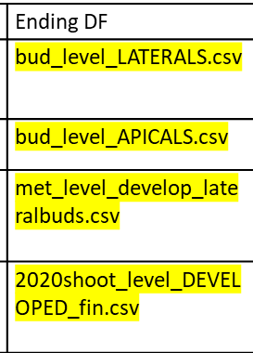


What will we use
Bud scale
Metamer scale
Shoot scale

Slide 10
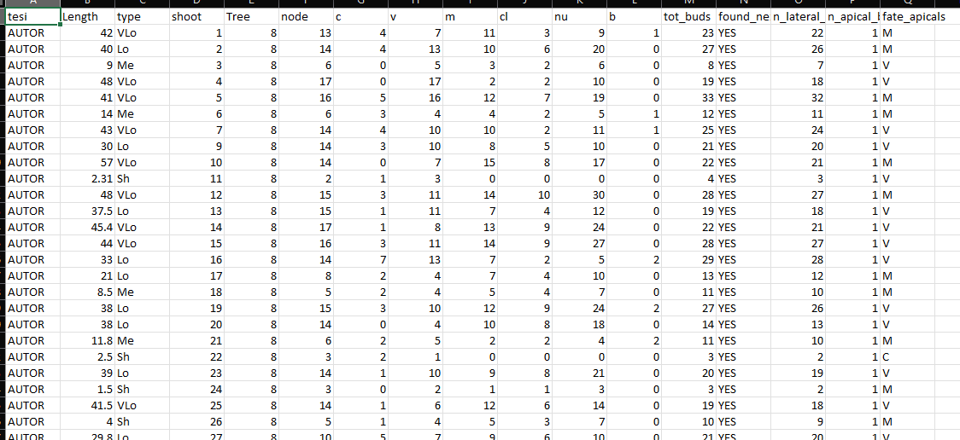
Shoot scale
Description of each shoot composition in terms of:
row ID
Not grafted
Plant ID mother of the shoot
Length(cm);
Length(class);
Number of nodes;
Number of buds per type (C,V,M,B);
Number of clusters;
Number of nuts;

Slide 11
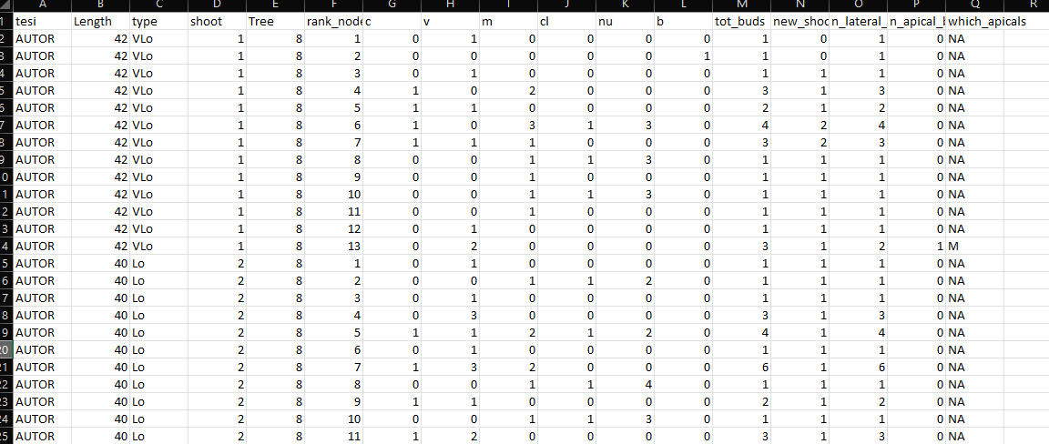
Metamer scale
Description of each metamer composition in terms of:
Year of sampling
Not grafted
Shoot length(class);
Shoot ID
Shoot length(cm);
Metamer ID
Number of LATERAL buds per eac rank (C,V,M,B);
Total buds per rank;
Shoots developed at that rank;
NUMBER LATERAL BUDS
NUMBER APICAL BUDS
FATE OF APICAL BUDS

Slide 12
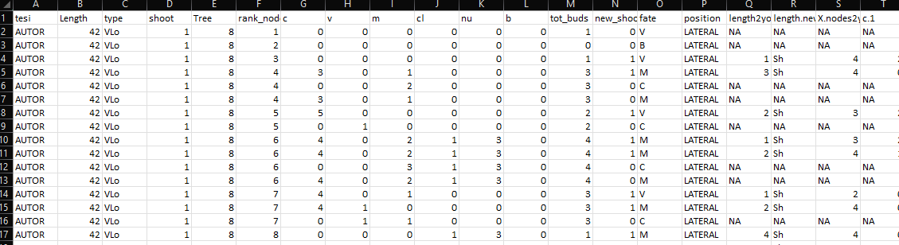
Bud scale
Description of each bud composition in terms of:
New shoot ID
Year of parent sampling
Shoot ID
Shoot length(cm);
Metamer ID
Number of sibling buds at the same node(C,V,M,B);
Total buds per node;
Number of Shoots developed at that rank;
Fate of bud (one per each row)
Position of the bud (apical/lateral)
Length of new shoot(cm)
Length of new shoot(class)
Information regarding each new shoot composition

Slide 13
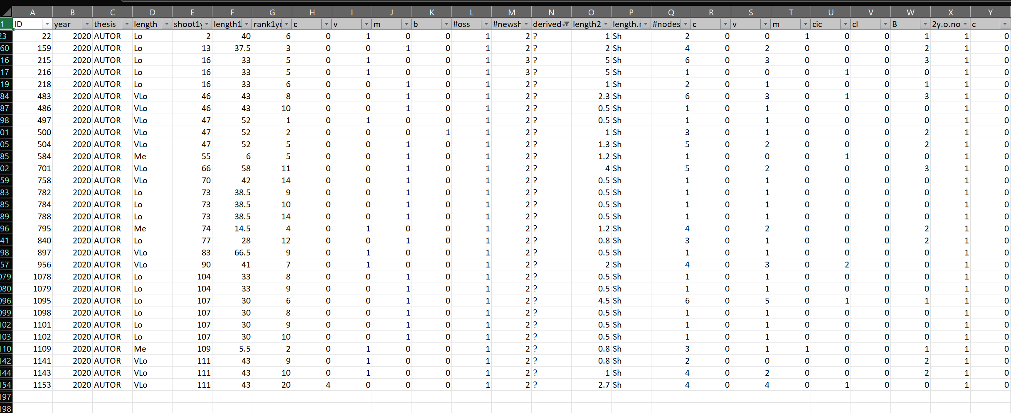
The original «new_shoots» file has the same information of the bud fate scale(in terms of new shoots details) plus it contains some the errors.
Errors= new shoots that i can’t explain from where they came from. Assigned as «?»
These errors impact less than 3% on the totals, so i guess we can ignore them and use the bud_scale file also for new shoots. What do you thing?

Slide 14
GLMs example
glm(Y~F1+F2+F3+F4+F5+F6+F7, family=«binomial»)
PREDICTORS
Two GLMs:
For fate=V
For fate=M
F1
F2
F3
F4
F5
F6
F7
Y
How to Interpret glm Output in R (With Example) - Statology

Slide 15
Problems & solutions
Several predictors mask their effects (ES. NA values)
Run different GLMs avoid each time a predictor:
Y~tot_buds+length+rank
Y~M+V+C+length+rank
p. Value are significant because we have many data. Is real significance?
Permutation models + difference in AIC

Slide 16
Permutation models
GLMS(Y~A+B+C, data=DF)
Shows that A is really significant (***)
Permutation
We shuffle the variable A: DF$A=sample(DF$A)
We run again the glms GLMS(Y~A+B+C, data=DF)
If the significance was true, now A should be not significant any more
AIC difference
GLMS(Y~A+B+C, data=DF)
Shows that AIC is 800
AIC difference
We run a null model GLMS(Y~1, data=DF)
We make the difference between AIC real (800) and AIC null
Now we make permutation of a variable and we run again the model.
AICpermutation-AICnull should be GREATER than AICreal-AICnull!!!
Null models are made as follows:
Y~1+(significant predictor not shuffled).
Example in next slide

Slide 17
Make GLMs
Find dipendent variable (Y) and predictor (A). NB_start with 1 predictor and if it is significant, add the others.
Run the model glm(Y~A)
Is A significant?
No. → Stop. Try another predictor (B);
Yes. →
do 100 permutation (A=sample(A), for 100 times);
Find aic null model (Y~1);
Make aic null – aic permutation (Y~sample(A)) for 100 times;
Count how many (out of 100)of them are greater than aic null – aic real (Y~A)
Find another predictor (B);
Run the glm (Y~A+B)
Is B significant?
No. → stop. Try with another predictor (C);
Yes→do 100 permutation (B=sample(B), for 100 times);
Find aic null model (Y~A+1);
Make aic null – aic permutation (Y~sample(B)) for 100 times;
Count how many (out of 100)of them are greater than aic null – aic real (Y~A+B)
Continue like this with all predictors

Slide 18
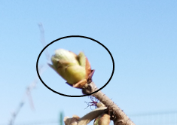
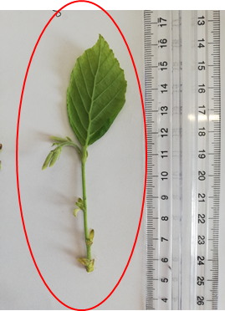

First approach to modelling
Box0:
How many nodes in that shoot
Box1:
Does that rank bear a sylleptic?
NO
Box1.0: Existence of B (0,1)?
YES
Box2: how many buds?
Box2: how many V and M buds?
Box3: proportion of V?
Box3: proportion of V ?
Box4: do you burst?
Box:3.1Proportion of M?
Box:3.1Proportion of M?
Box4: do you burst?
Box5: How many nodes OF NEW SHOOTS?
Box5: How many nodes OF NEW SHOOTS?

Slide 19
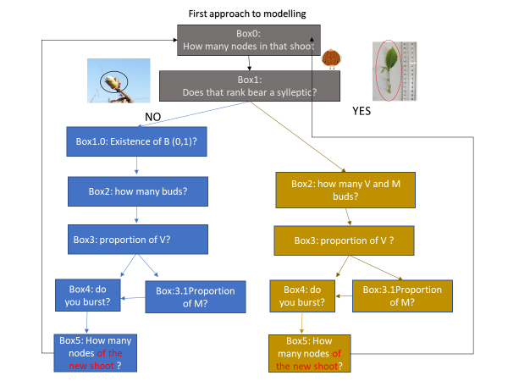
Box0:
How many nodes in that shoot
Is missing the info regarding length distributio:
Acquisition of data in summer 2022

Slide 20
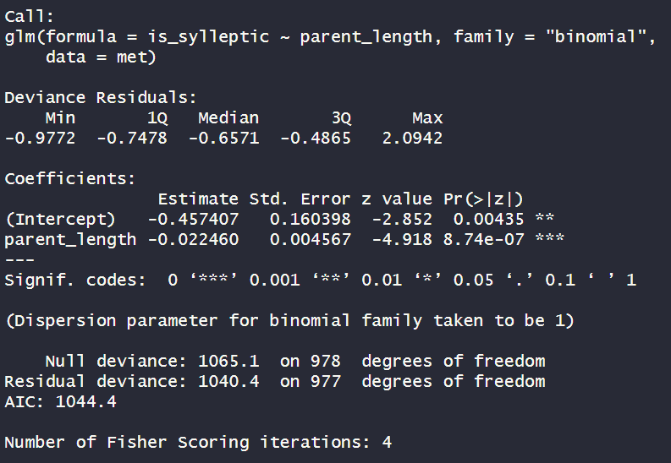
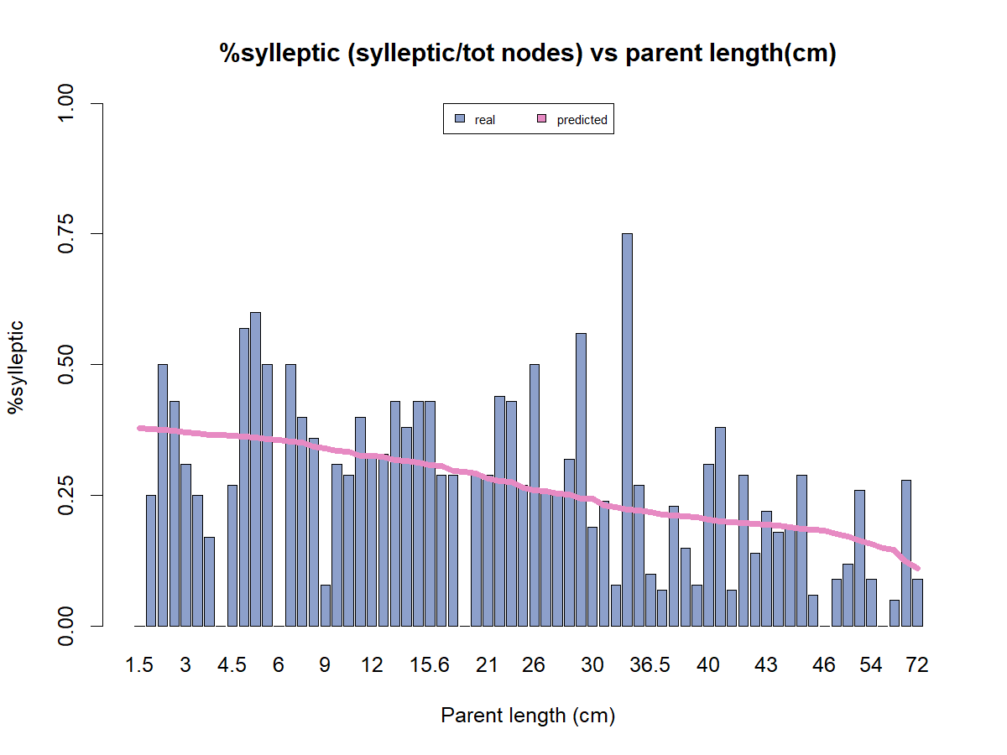
Box1:Does that rank bear a sylleptic?
~parental_length(cm)
Length is significant (***). Coef -0.02

Slide 21
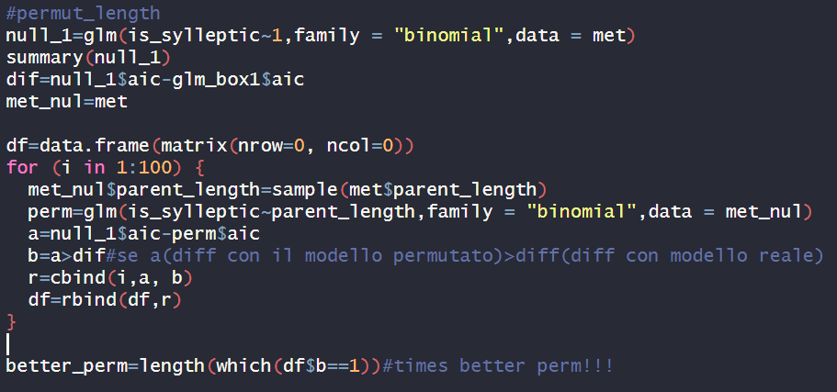
Box1: Does that rank bear a sylleptic?
Permutation
0 times out of 100 the aic of null model- aic of permutated ones was greater than the difference with real model

Slide 22
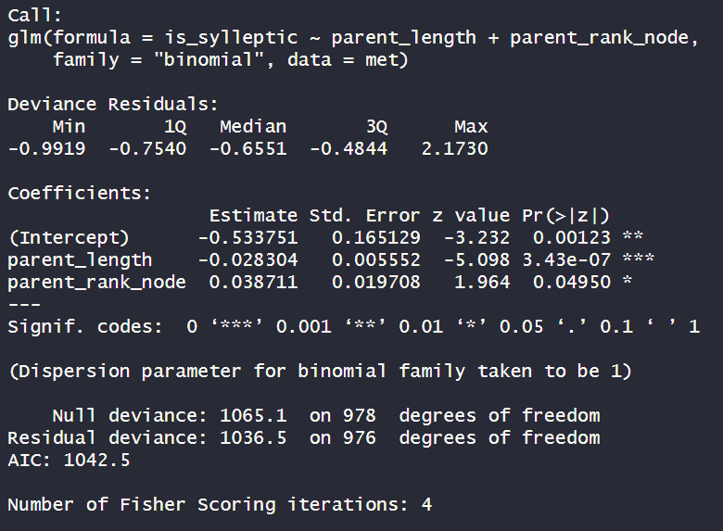
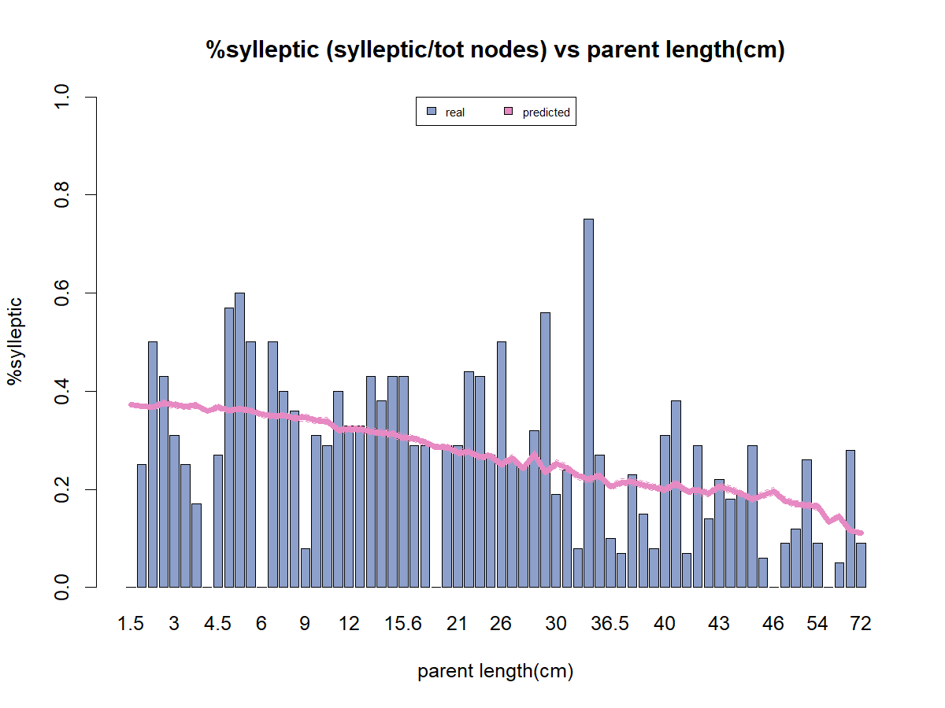
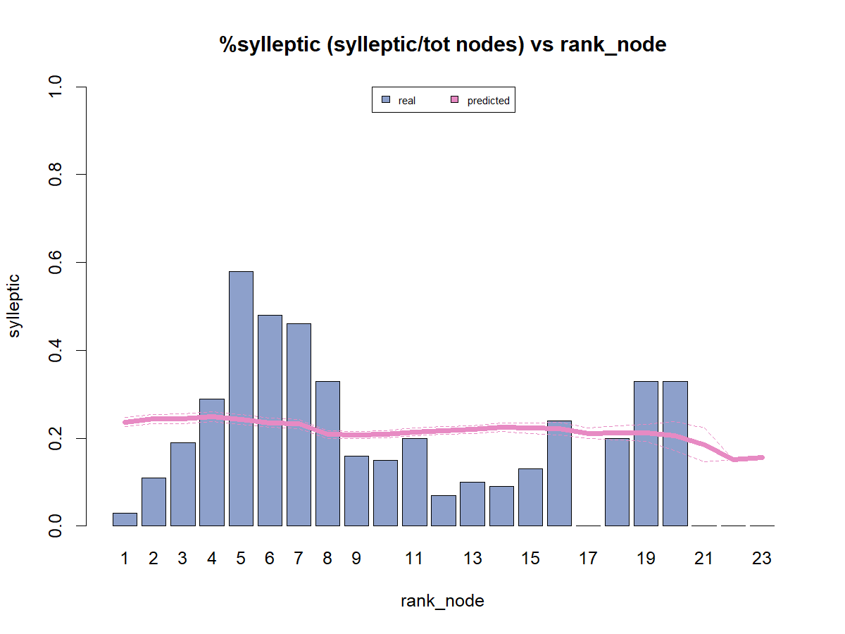
Box1:Does that rank bear a sylleptic?
~parental_length(cm)+parental_rank_node
Length is significant(***).Coef=-0.03
Rank is significant(*).Coef=+0.04

Slide 23
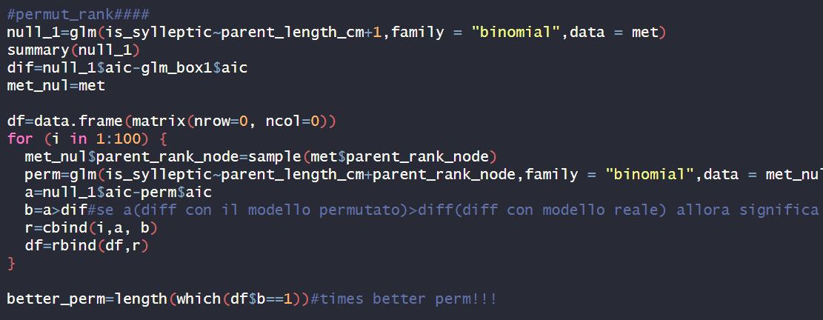
Box1:Does that rank bear a sylleptic?
Permutation
4 times out of 100 the aic of null model- aic of permutated ones was greater than the difference with real model

Slide 24
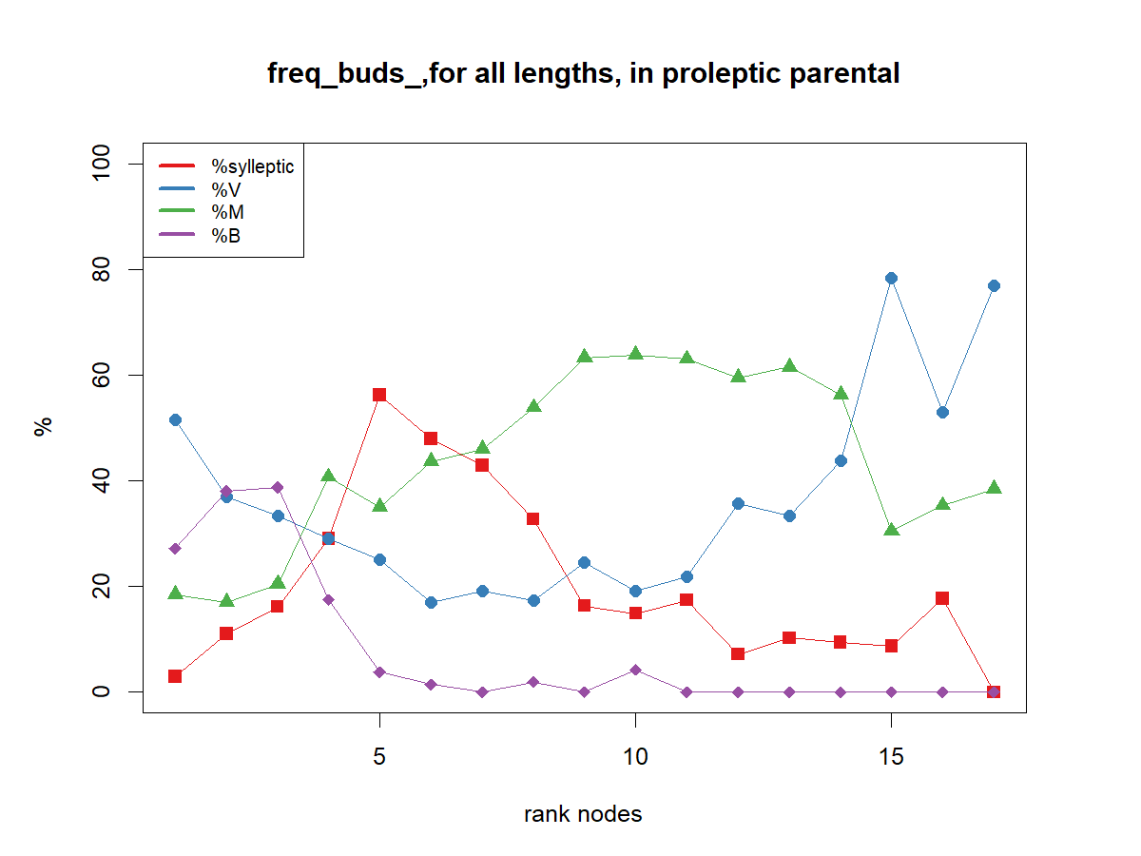
Because sylleptic are distributed in the median zone along the parent shoot, the rank does not have a linear effect:
we compute for each bud the distance to the shoot extremities,
0 is the median rank of each shoot

Slide 25
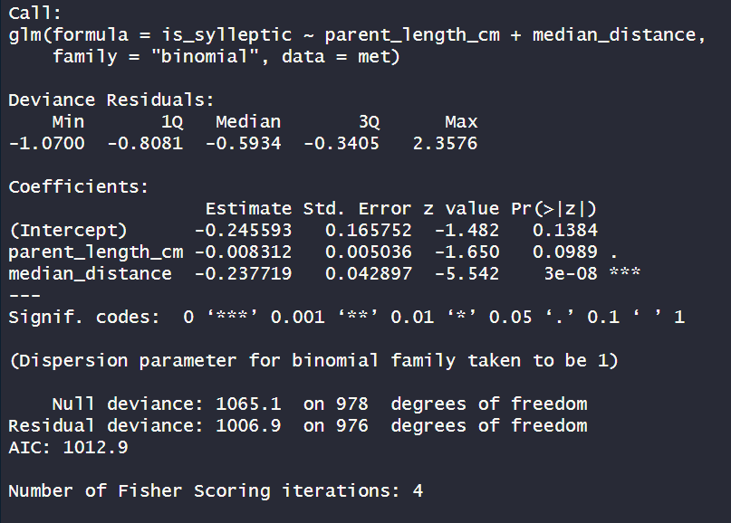
Box1: Does that rank bear a sylleptic?
~length(cm)+distance
Length NOT significant
Distance is significant (***). Coef?-0.23
The correct way to model is to keep the distance instead of length or rank

Slide 26
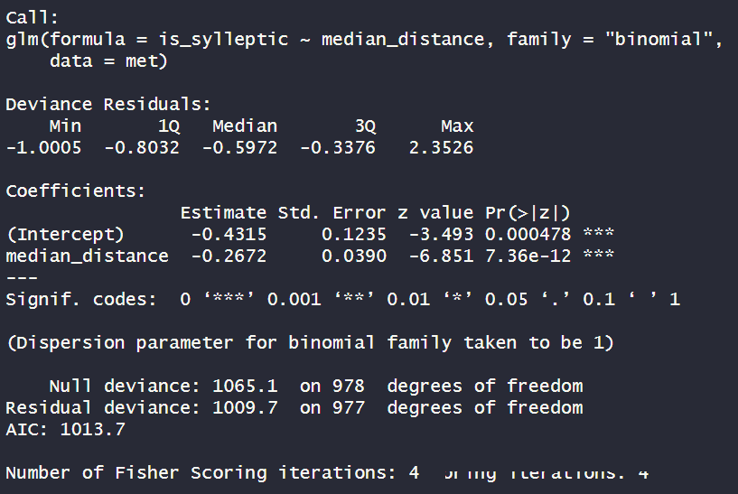
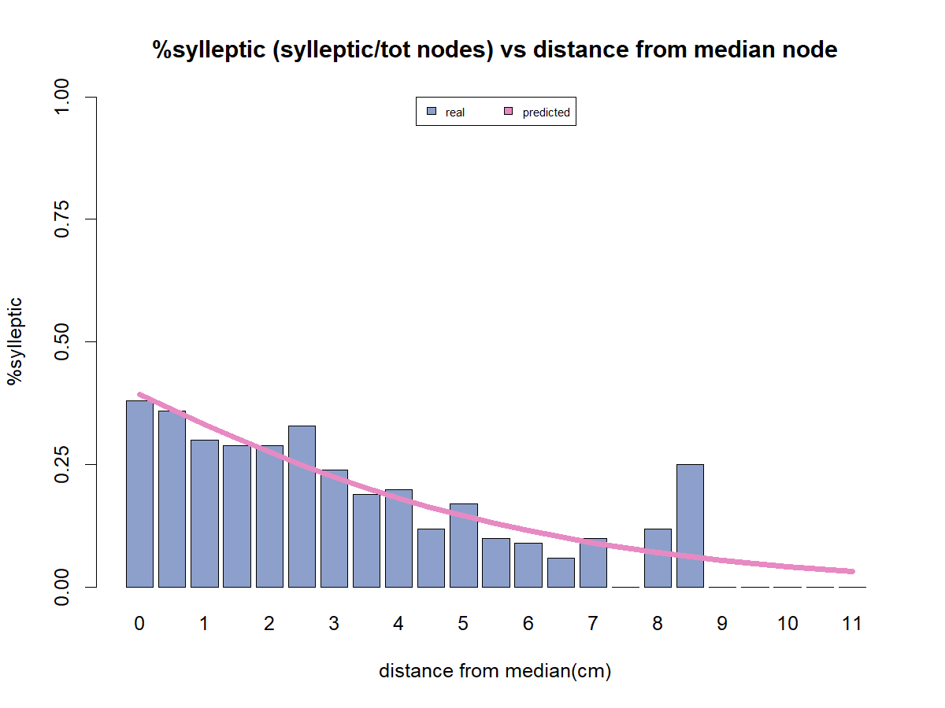
Box1:Does that rank bear a sylleptic?
~distance
distance is significant (***). Coef?-0.26

Slide 27
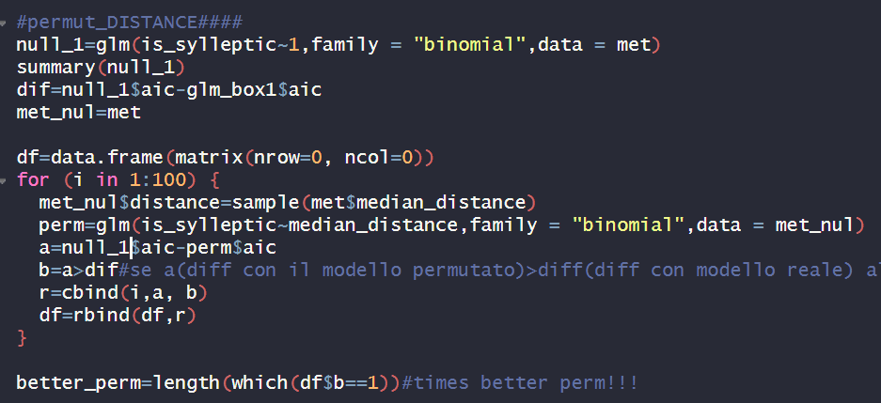
Box1:Does that rank bear a sylleptic?
Permutation
0 times out of 100 the aic of null model- aic of permutated ones was greater than the difference with real model

Slide 28

First approach to modelling
Box0:
How many nodes in that shoot
~Distance
Box1:
Does that rank bear a sylleptic?
Box1.0: Existence of B (0,1)?
Box2: how many buds?
Box2: how many V and M buds?
Box3: proportion of V?
Box3: proportion of V ?
Box4: do you burst?
Box:3.1Proportion of M?
Box:3.1Proportion of M?
Box4: do you burst?
Box5: How many nodes OF NEW SHOOTS?
Box5: How many nodes OF NEW SHOOTS?

Slide 29
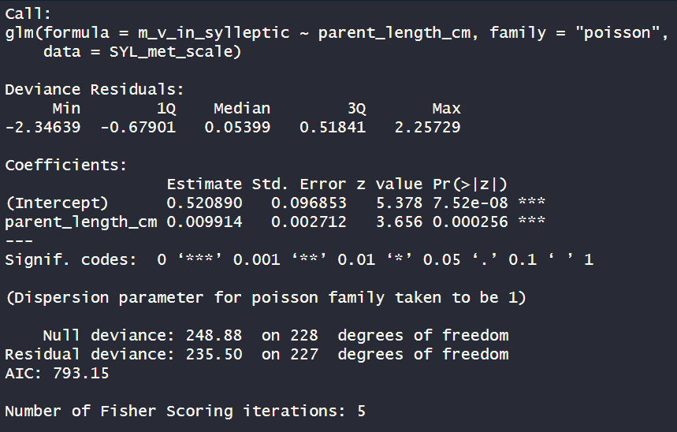
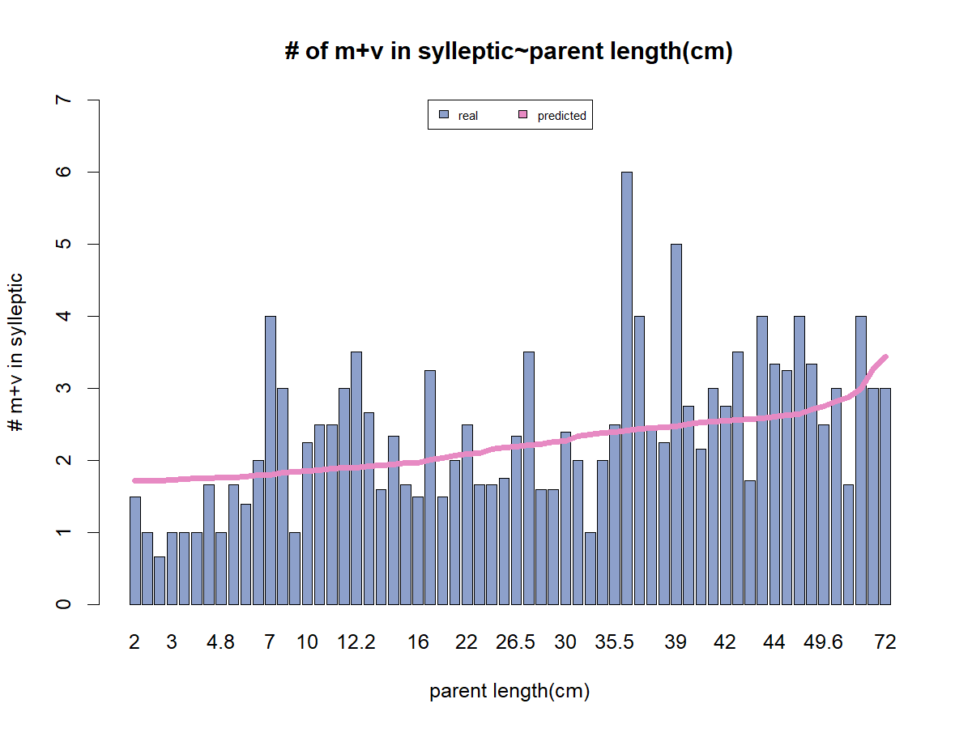
Box2: how many V and M buds?
~parent shoot length(cm)
Length is significant (***). Coef +0.009

Slide 30
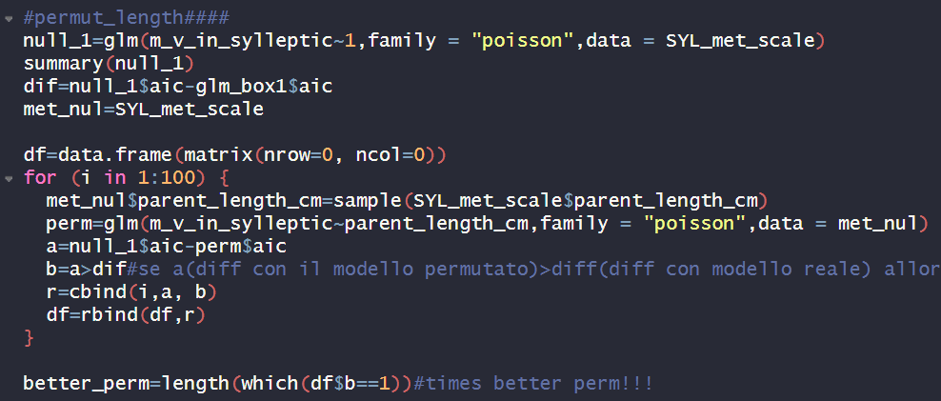
Box2: how many V and M buds?
Permutation
0 times out of 100 the aic of null model- aic of permutated ones was greater than the difference with real model

Slide 31
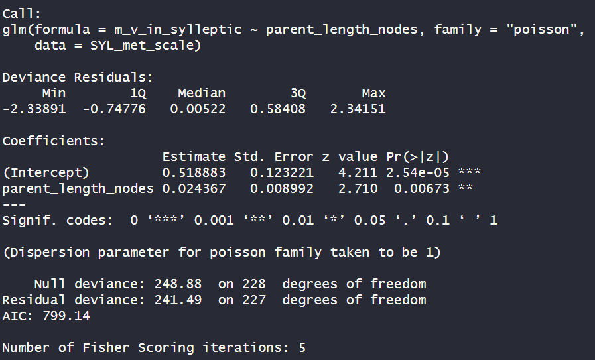
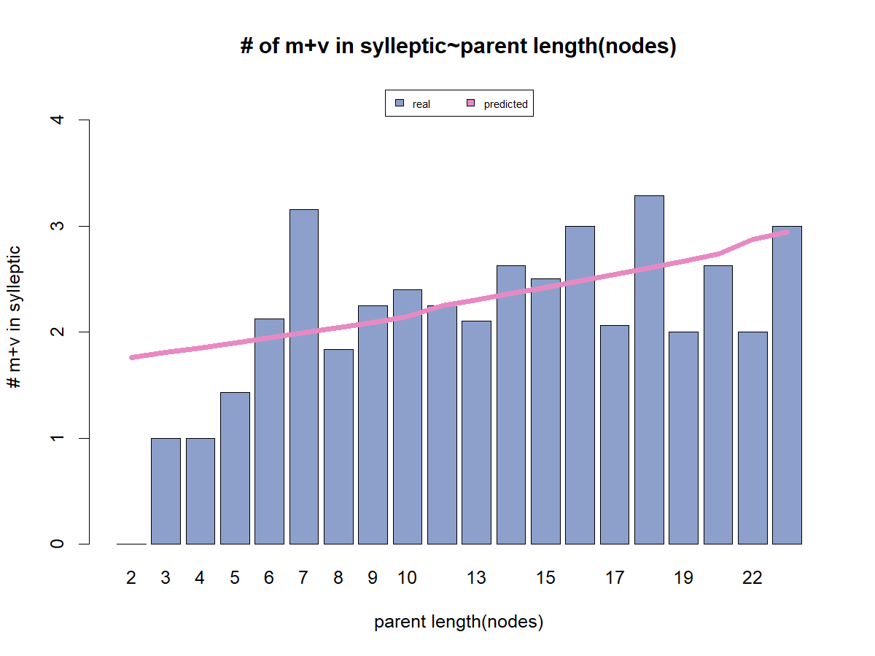
Box2: how many V and M buds?
~parent shoot LENGTH (node)
Length is significant (**). Coef +0.02

Slide 32
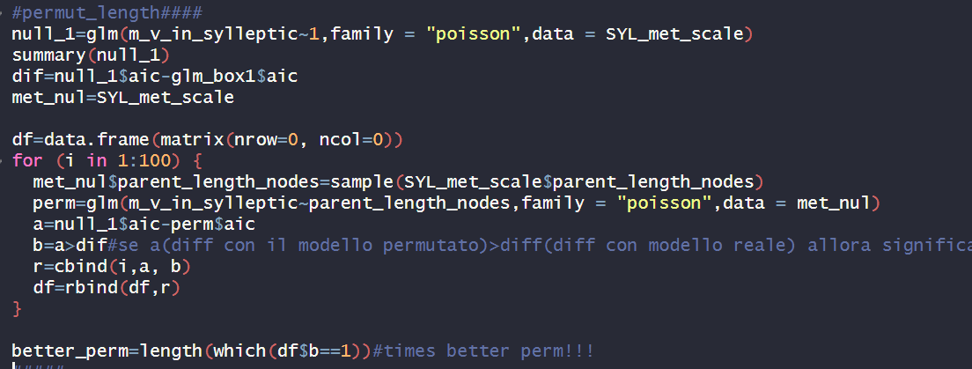
Box2: how many V and M buds?
Permutation
1 times out of 100 the aic of null model- aic of permutated ones was greater than the difference with real model

Slide 33
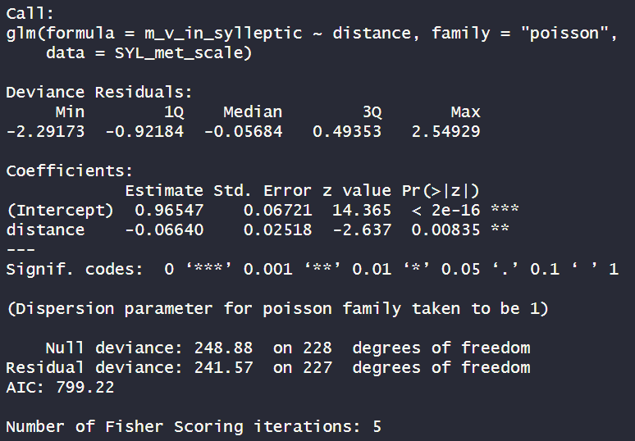
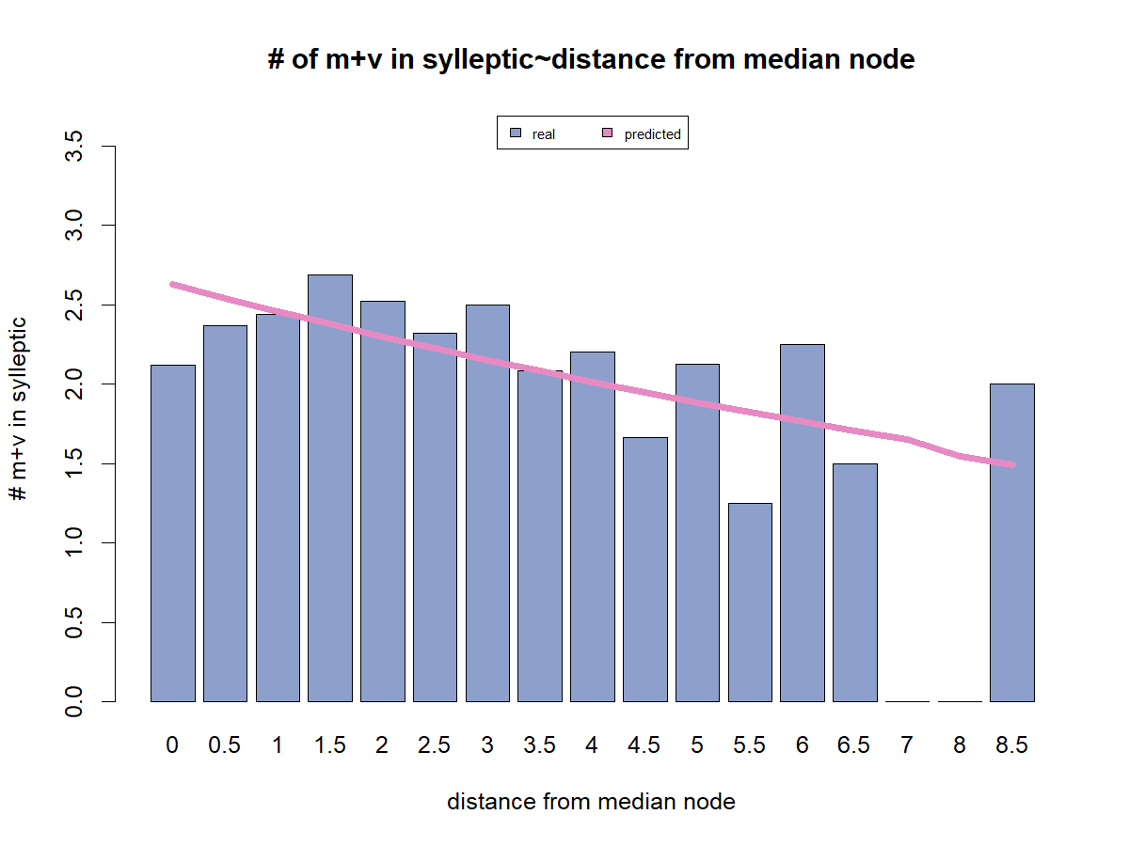
Box2: how many V and M buds?
~distance to median node
distance is significant (**). Coef -0.07

Slide 34
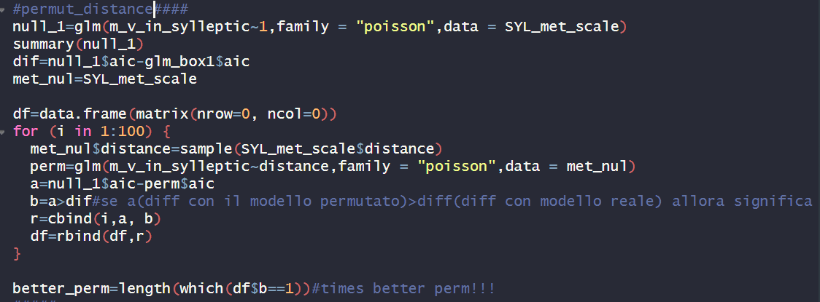
Box2: how many V and M buds?
Permutation
0 times out of 100 the aic of null model- aic of permutated ones was greater than the difference with real model

Slide 35
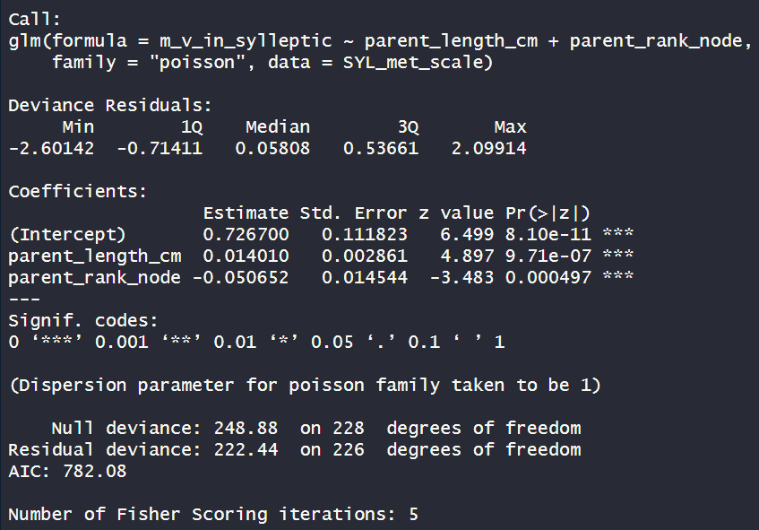
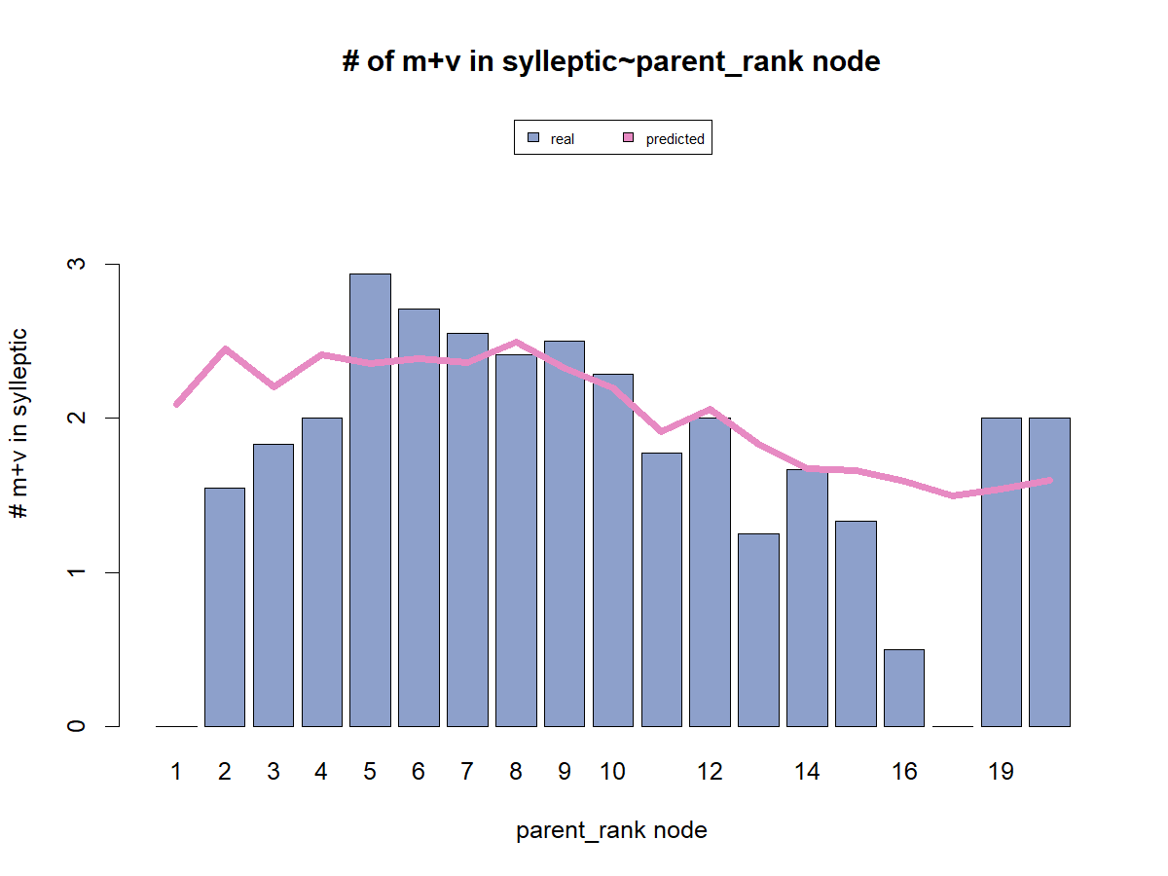
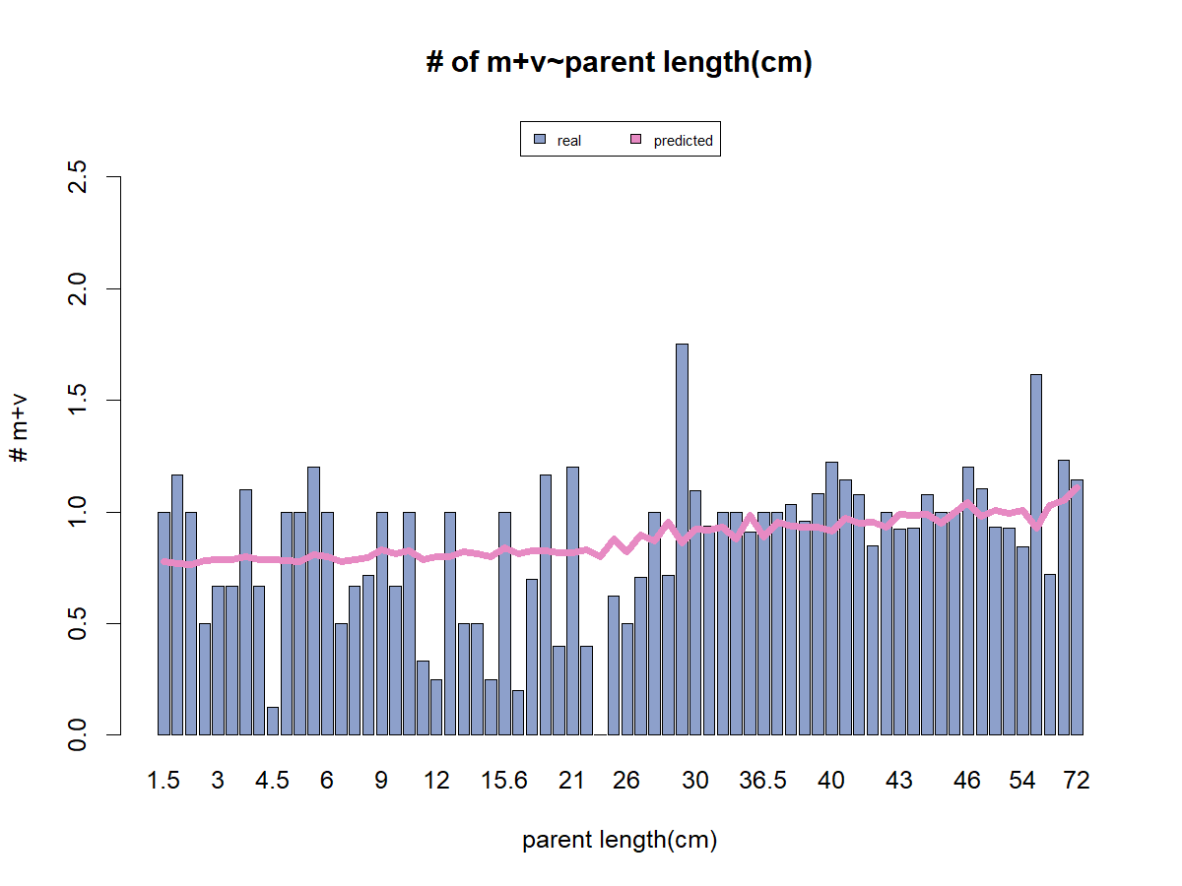
Box2: how many V and M buds?
~length(cm)+rank
Conc:
Length is significant (***). Coef +0.01
Rank is significant (***). Coef=-0.05

Slide 36
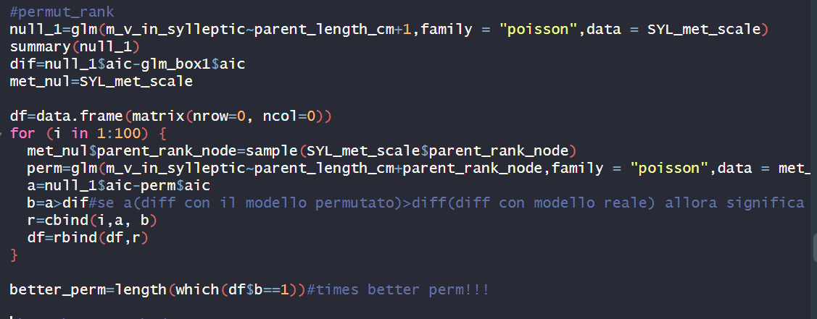
Box2: how many V and M buds?
Permutation
0 times out of 100 the aic of null model- aic of permutated ones was greater than the difference with real model

Slide 37
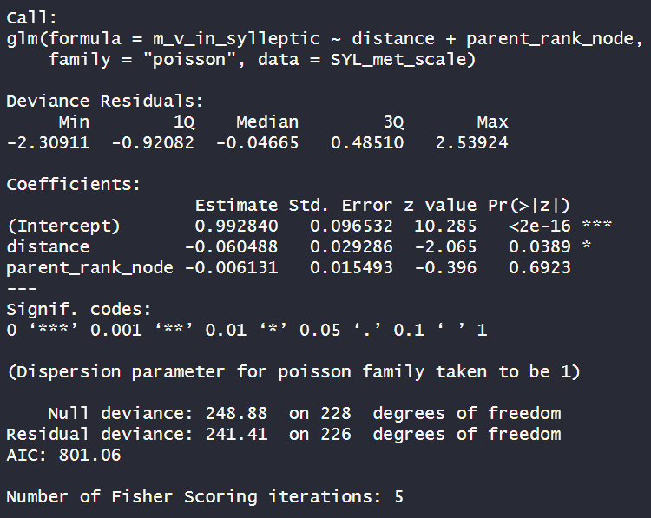
Box2: how many V and M buds?
~distance+RANK
Rank node not significant
distance is significant (*). Coef -0.06

Slide 38
First approach to modelling
Box0:
How many nodes in that shoot
~Distance
Box1:
Does that rank bear a sylleptic?
Box1.0: Existence of B (0,1)?
~lengt(cm)+rank node
Box2: how many buds?
Box2: how many V and M buds?
Box3: proportion of V?
Box3: proportion of V ?
Box4: do you burst?
Box:3.1Proportion of M?
Box:3.1Proportion of M?
Box4: do you burst?
Box5: How many nodes OF NEW SHOOTS?
Box5: How many nodes OF NEW SHOOTS?

Slide 39
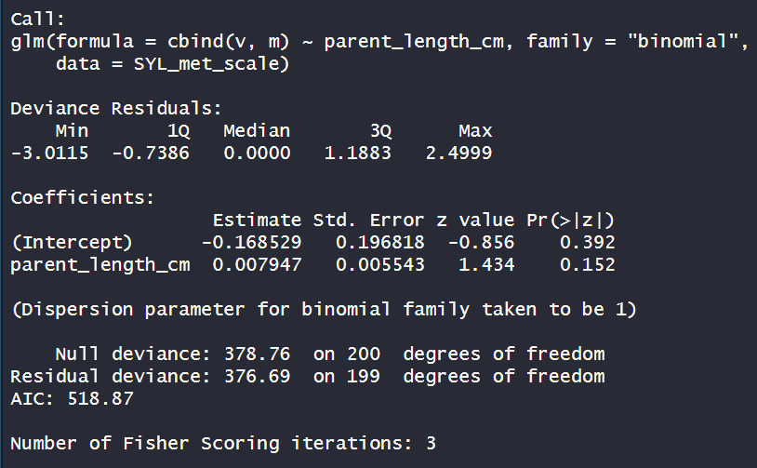
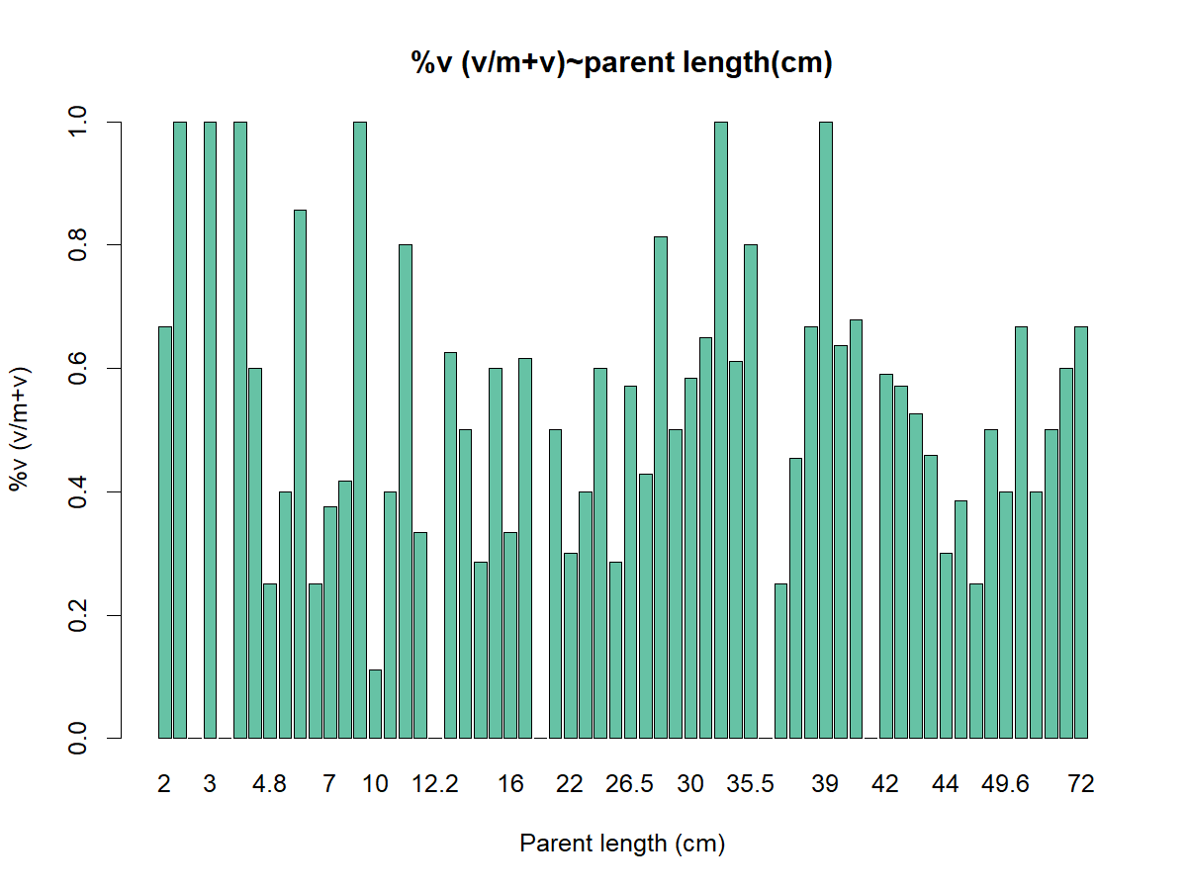
Box3: proportion of V ?
~length(cm)
Length is not significant

Slide 40
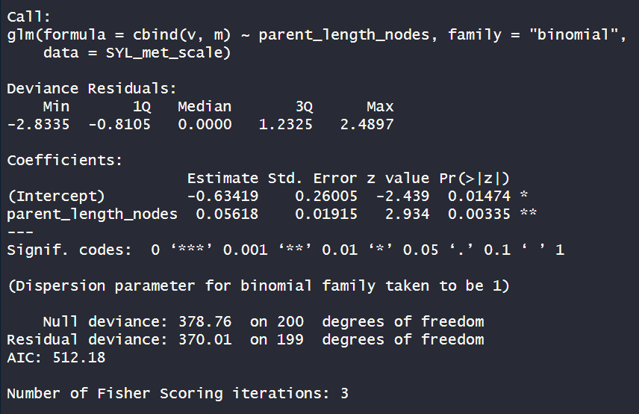
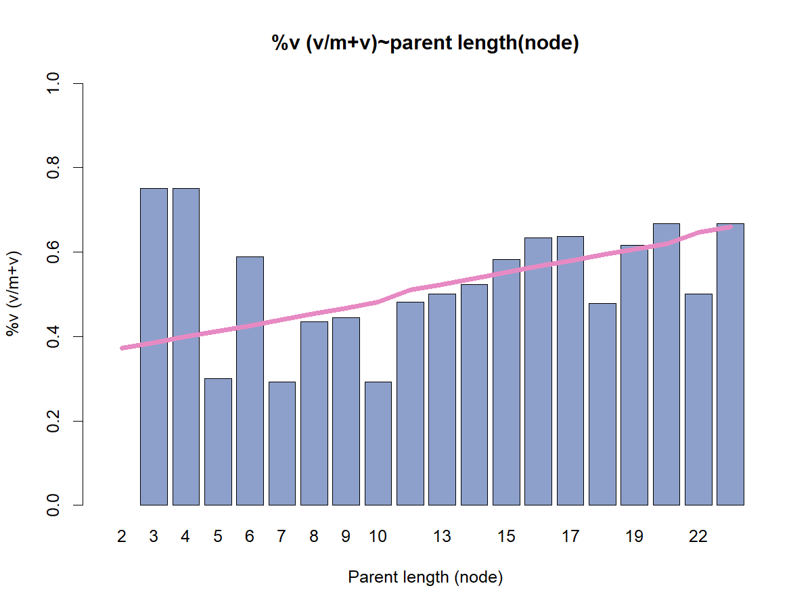
Box3: proportion of V ?
~length(nodes)
Length is significant (**). Coef=+0.06

Slide 41
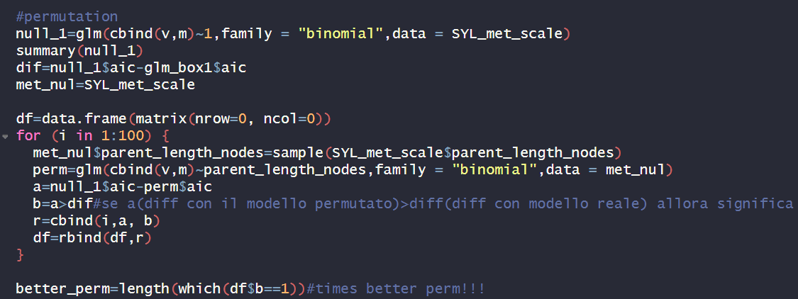
Box2: how many V and M buds?
Permutation
4 times out of 100 the aic of null model- aic of permutated ones was greater than the difference with real model

Slide 42
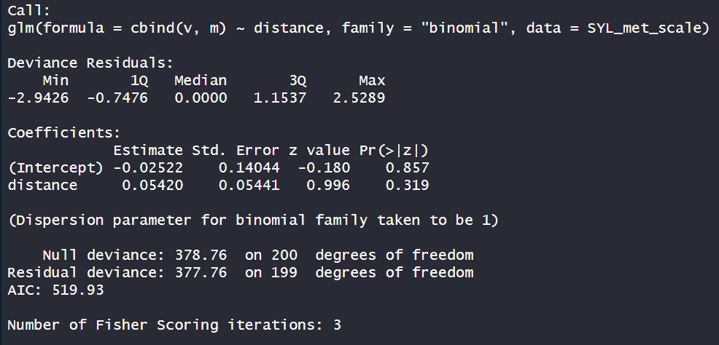
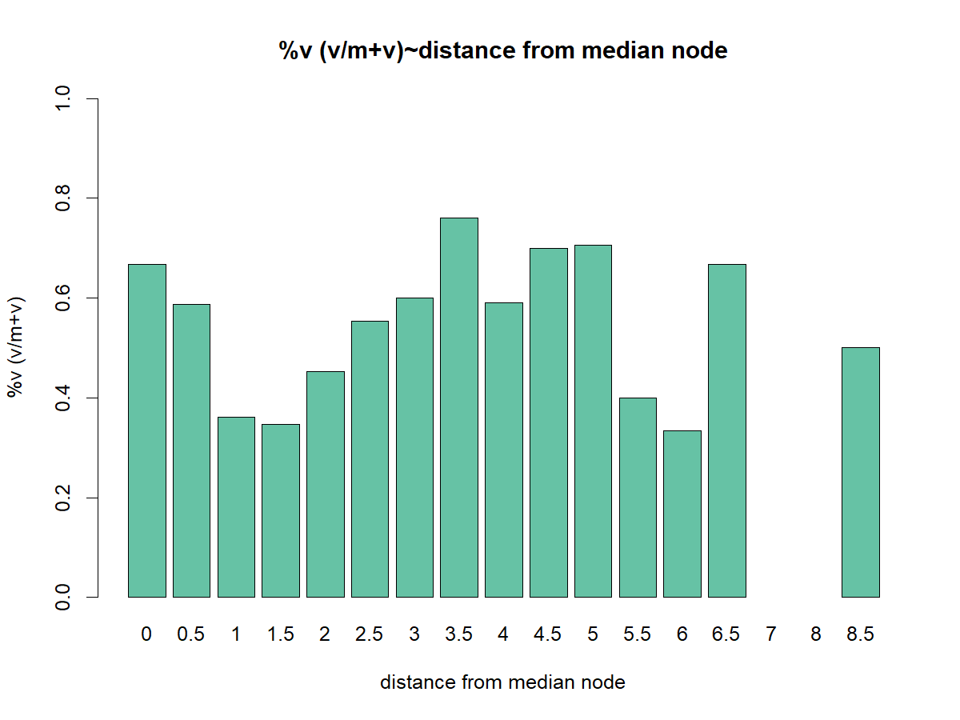
Box3: proportion of V ?
~distance from median node
distance is not sgnificant

Slide 43
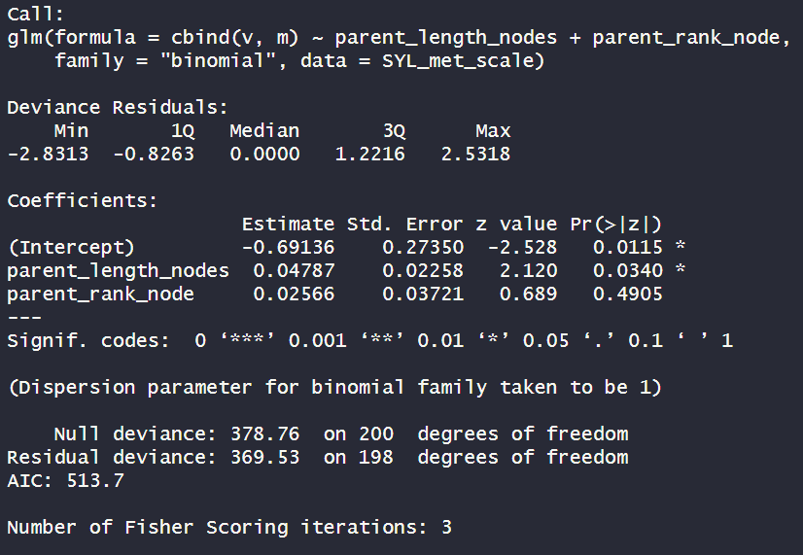
Box3: proportion of V ?
~length(nodes)+rank
rank is not significant
Length is significant (*). Coef=+0.04

Slide 44
First approach to modelling
Box0:
How many nodes in that shoot
~Distance
Box1:
Does that rank bear a sylleptic?
Box1.0: Existence of B (0,1)?
~lengt(cm)+rank node
Box2: how many buds?
Box2: how many V and M buds?
Box3: proportion of V?
Box3: proportion of V ?
~lengt(cm)
Box4: do you burst?
Box:3.1Proportion of M?
Box:3.1Proportion of M?
Box4: do you burst?
Box5: How many nodes OF NEW SHOOTS?
Box5: How many nodes OF NEW SHOOTS?

Slide 45
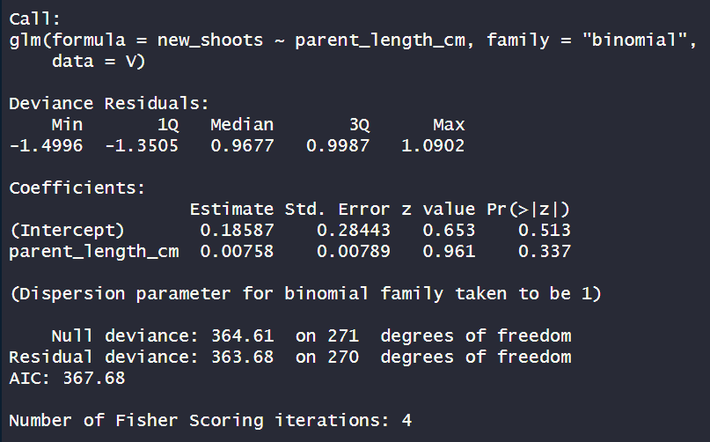

From V
Box4: do you burst?
~parent LENGTH
New shoots (1=present, 0=absent), from V buds, related to parent length in sylleptic shoots
Length IS NOT significant

Slide 46


From V
Box4: do you burst?
~parental RANK
New shoots (1=present, 0=absent), from V buds related to parentr ank in sylleptic shoots
RANK IS NOT significant

Slide 47


From V
Box4: do you burst?
~distance
New shoots (1=present, 0=absent), from V buds, related to distance between parent ranks in sylleptic shoots
distance IS NOT significant

Slide 48


Box4: do you burst?
From V
~TOT BUDS in that sylleptic
New shoots (1=present, 0=absent), in V buds, related other m+v buds in the sylleptic shoot
Sibling_buds_mv is significant (***). Coef=-0.44

Slide 49

From V
Box4: do you burst?
Permutation
0 times out of 100 the aic of null model- aic of permutated ones was greater than the difference with real model

Slide 50


From V
Box4: do you burst?
~ other V in that sylleptic
New shoots (1=present, 0=absent), in V buds, other v in the same sylleptic
V is significant(***). Coef: -0.60

Slide 51

From V
Box4: do you burst?
Permutation
0 times out of 100 the aic of null model- aic of permutated ones was greater than the difference with real model

Slide 52


From V
Box4: do you burst?
~ siblings V + siblings M
New shoots (1=present, 0=absent), in V buds,related to other v and m in the same sylleptic
M IS NOT SIGNIFICANT

Slide 53
First approach to modelling
Box0:
How many nodes in that shoot
~Distance
Box1:
Does that rank bear a sylleptic?
Box1.0: Existence of B (0,1)?
~lengt(cm)+rank node
Box2: how many buds?
Box2: how many V and M buds?
Box3: proportion of V?
Box3: proportion of V ?
~lengt(cm)
Box4: do you burst?
Box:3.1Proportion of M?
Box:3.1Proportion of M?
Box4: do you burst?
If V: other V
Box5: How many nodes OF NEW SHOOTS?
Box5: How many nodes OF NEW SHOOTS?

Slide 54


From M
Box4: do you burst?
~LENGTH of parent shoot
New shoots (1=present, 0=absent), in M buds, related to length of parent shoot
Length IS NOT significant

Slide 55


From M
Box4: do you burst?
~RANK of parent shoot
New shoots (1=present, 0=absent), in M buds, related to rank node of that sylleptic
RANK IS NOT significant

Slide 56


From M
Box4: do you burst?
~distance from median node
New shoots (1=present, 0=absent), from M buds, related to distance to median rank in sytlleptic shoots
distance IS significant (*). Coef: -0.2

Slide 57

Box4: do you burst?
From M
Permutation
2 times out of 100 the aic of null model- aic of permutated ones was greater than the difference with real model

Slide 58

Box4: do you burst?
From M
~distance + sibling buds in that sylleptic
New shoots (1=present, 0=absent), in M buds, related distance +other m+v buds in the sylleptic shoot
Tot buds is significant (***). Coef=-0.50
Distance is not significant any more!

Slide 59


Box4: do you burst?
From M
~siblings in that sylleptic
New shoots (1=present, 0=absent), in M buds, related other m+v buds in the sylleptic shoot
Tot buds is significant (***). Coef=-0.52

Slide 60

Box4: do you burst?
From M
Permutation
0 times out of 100 the aic of null model- aic of permutated ones was greater than the difference with real model

Slide 61

From M
Box4: do you burst?
~other V in that sylleptic
New shoots (1=present, 0=absent), in M buds, other v in the same sylleptic
V is not significant

Slide 62


Box4: do you burst?
From M
~ siblings M in that sylleptic
New shoots (1=present, 0=absent), in M buds, other m in the same sylleptic
M is significant (***). Coef=-0.60

Slide 63

Box4: do you burst?
From M
Permutation
0 times out of 100 the aic of null model- aic of permutated ones was greater than the difference with real model

Slide 64
First approach to modelling
Box0:
How many nodes in that shoot
~Distance
Box1:
Does that rank bear a sylleptic?
Box1.0: Existence of B (0,1)?
~lengt(cm)+rank node
If M: other M
Box2: how many buds?
Box2: how many V and M buds?
Box3: proportion of V?
Box3: proportion of V ?
~lengt(cm)
Box4: do you burst?
Box:3.1Proportion of M?
Box:3.1Proportion of M?
Box4: do you burst?
If V: other V
Box5: How many nodes OF NEW SHOOTS?
Box5: How many nodes OF NEW SHOOTS?

Slide 65


Box2.0: Existence of B (0,1)?
~shoot length(cm)
length is significant (***). Coef=-0.04

Slide 66

Box2.0: Existence of B (0,1)?
Permutation
0 times out of 100 the aic of null model- aic of permutated ones was greater than the difference with real model

Slide 67


Box2.0: Existence of B (0,1)?
~shoot length(nodes)
length is significant (***). Coef=-0.11

Slide 68

Box2.0: Existence of B (0,1)?
Permutation
0 times out of 100 the aic of null model- aic of permutated ones was greater than the difference with real model

Slide 69

Box2.0: Existence of B (0,1)?
~shoot LENGTH+RANK node
RANK is significant (***). Coef=-0.42
But length(nodes) no
Because length(node) is no more significant, I use rank node to model the presence of blind buds

Slide 70


Box2.0: Existence of B (0,1)?
~RANK node
RANK is significant (***). Coef=-0.42

Slide 71

Box2.0: Existence of B (0,1)?
Permutation
0 times out of 100 the aic of null model- aic of permutated ones was greater than the difference with real model

Slide 72
First approach to modelling
Box0:
How many nodes in that shoot
~Distance
Box1:
Does that rank bear a sylleptic?
~Rank node
Box1.0: Existence of B (0,1)?
~lengt(cm)+rank node
If M: other M
Box2: how many buds?
Box2: how many V and M buds?
Box3: proportion of V?
Box3: proportion of V ?
~lengt(cm)
Box4: do you burst?
Box:3.1Proportion of M?
Box:3.1Proportion of M?
Box4: do you burst?
If V: other V
Box5: How many nodes OF NEW SHOOTS?
Box5: How many nodes OF NEW SHOOTS?

Slide 73

Box2: how many buds?
~shoot length(cm)
Length is significant(**). Coef=+0.007

Slide 74

Box2: how many buds?
Permutation
0 times out of 100 the aic of null model- aic of permutated ones was greater than the difference with real model

Slide 75


Box2: how many buds?
~shoot length(nodes)
Length is significant(*). Coef=+0.018

Slide 76

Box2: how many buds?
Permutation
0 times out of 100 the aic of null model- aic of permutated ones was greater than the difference with real model

Slide 77


Box2: how many buds?
~distance from the median node
Distance is not significant

Slide 78

Box2: how many buds?
~length(cm) +rank node
Length is not significant
Rank is significant(**). Coef=+0.03
Because length(cm) is no more significant, I use rank node

Slide 79


Box2: how many buds?
~rank node
Rank is significant(***). Coef=+0.03

Slide 80

Box2: how many buds?
Permutation
0 times out of 100 the aic of null model- aic of permutated ones was greater than the difference with real model

Slide 81
First approach to modelling
Box0:
How many nodes in that shoot
~Distance
~Rank node
Box1:
Does that rank bear a sylleptic?
~Rank node
Box1.0: Existence of B (0,1)?
~lengt(cm)+rank node
If M: other M
Box2: how many buds?
Box2: how many V and M buds?
Box3: proportion of V?
Box3: proportion of V ?
~lengt(cm)
Box4: do you burst?
Box:3.1Proportion of M?
Box:3.1Proportion of M?
Box4: do you burst?
If V: other V
Box5: How many nodes OF NEW SHOOTS?
Box5: How many nodes OF NEW SHOOTS?

Slide 82


Box3: proportion of V?
~shoot LENGTH
Length is not significant

Slide 83


Box3: proportion of V?
~shoot LENGTH(nodes)
Length is not significant

Slide 84


Box3: proportion of V?
~distance from median
Distance is significant(***).Coef=+0.24

Slide 85

Box3: proportion of V?
Permutation
0 times out of 100 the aic of null model- aic of permutated ones was greater than the difference with real model

Slide 86



Box3: proportion of V?
~rank node
Rank is significant (*). Coef=-0.03

Slide 87

Box3: proportion of V?
Permutation
7 times out of 100 the aic of null model- aic of permutated ones was greater than the difference with real model

Slide 88
First approach to modelling
Box0:
How many nodes in that shoot
~Distance
~Rank node
Box1:
Does that rank bear a sylleptic?
~Rank node
Box1.0: Existence of B (0,1)?
~lengt(cm)+rank node
If M: other M
Box2: how many buds?
Box2: how many V and M buds?
~distance
~lengt(cm)
Box3: proportion of V?
Box3: proportion of V ?
Box4: do you burst?
Box:3.1Proportion of M?
Box:3.1Proportion of M?
Box4: do you burst?
If V: other V
Box5: How many nodes OF NEW SHOOTS?
Box5: How many nodes OF NEW SHOOTS?

Slide 89


Box4: do you burst?
From V
~LENGTH
Length is significant(**). Coef: 0.02
New shoots (1=present, 0=absent)

Slide 90

Box4: do you burst?
Permutation
2 times out of 100 the aic of null model- aic of permutated ones was greater than the difference with real model

Slide 91

Box4: do you burst?
From V
~length+Rank
Length is not significant
Rank is significant(*). Coef: 0.06
New shoots (1=present, 0=absent)

Slide 92


Box4: do you burst?
From V
Rank is significant(**). Coef: 0.08
~rank
New shoots (1=present, 0=absent)

Slide 93

Box4: do you burst?
Permutation
0 times out of 100 the aic of null model- aic of permutated ones was greater than the difference with real model

Slide 94


Box4: do you burst?
From V
Distance is significant(*). Coef: -0.1
~distance
New shoots (1=present, 0=absent)

Slide 95

Box4: do you burst?
Permutation
1 times out of 100 the aic of null model- aic of permutated ones was greater than the difference with real model

Slide 96



Box4: do you burst?
From V
~length +Tot_buds
Length is significant(**). Coef: 0.02
M+v is significant(**). Coef: -0.46
New shoots (1=present, 0=absent)

Slide 97

Box4: do you burst?
Permutation
0 times out of 100 the aic of null model- aic of permutated ones was greater than the difference with real model

Slide 98



Box4: do you burst?
From V
~length + other V in that rank
V is significant(***). Coef: -0.94
Length is significant(***). Coef: 0.02
New shoots (1=present, 0=absent)

Slide 99

Box4: do you burst?
Permutation
0 times out of 100 the aic of null model- aic of permutated ones was greater than the difference with real model

Slide 100


Box4: do you burst?
From V
~length +other M in that rank
M not significant
New shoots (1=present, 0=absent)

Slide 101
First approach to modelling
Box0:
How many nodes in that shoot
~Distance
~Rank node
Box1:
Does that rank bear a sylleptic?
~Rank node
Box1.0: Existence of B (0,1)?
~lengt(cm)+rank node
If M: other M
Box2: how many buds?
Box2: how many V and M buds?
~distance
~lengt(cm)
Box3: proportion of V?
Box3: proportion of V ?
Box4: do you burst?
Box:3.1Proportion of M?
Box:3.1Proportion of M?
Box4: do you burst?
If V: length +other V
If V: other V
Box5: How many nodes OF NEW SHOOTS?
Box5: How many nodes OF NEW SHOOTS?

Slide 102


Box4: do you burst?
From M
~LENGTH
Length is significant(**). Coef: 0.03
New shoots (1=present, 0=absent)

Slide 103

Box4: do you burst?
Permutation
0 times out of 100 the aic of null model- aic of permutated ones was greater than the difference with real model

Slide 104

Box4: do you burst?
From M
~length+rank
Length is not significant
Rank is significant(***). Coef: 0.21
New shoots (1=present, 0=absent)

Slide 105


Box4: do you burst?
From M
~rank
Rank is significant(***). Coef: 0.22
New shoots (1=present, 0=absent)

Slide 106

Box4: do you burst?
Permutation
0 times out of 100 the aic of null model- aic of permutated ones was greater than the difference with real model

Slide 107


Box4: do you burst?
From M
~distance
Distance is not significant
New shoots (1=present, 0=absent)

Slide 108



Box4: do you burst?
From M
Rank is significant(***). Coef=0.2
Siblings m+v is significant(***)-Coef=-0.91
~rank + sibling buds
New shoots (1=present, 0=absent)

Slide 109

Box4: do you burst?
Permutation
0 times out of 100 the aic of null model- aic of permutated ones was greater than the difference with real model

Slide 110



Box4: do you burst?
From M
Rank is significant(***). Coef=0.2
Siblings v is significant(***)-Coef=-1.39
~rank + siblings V
New shoots (1=present, 0=absent)

Slide 111

Box4: do you burst?
Permutation
0 times out of 100 the aic of null model- aic of permutated ones was greater than the difference with real model

Slide 112




Box4: do you burst?
From M
Rank is significant(***). Coef=0.2
Siblings v is significant(**).Coef=-1.09
Siblings m is significant(**).Coef=-0.8
~rank + siblings V+ siblings M
New shoots (1=present, 0=absent)

Slide 113

Box4: do you burst?
Permutation
0 times out of 100 the aic of null model- aic of permutated ones was greater than the difference with real model

Slide 114
First approach to modelling
Box0:
How many nodes in that shoot
~Distance
~Rank node
Box1:
Does that rank bear a sylleptic?
~Rank node
Box1.0: Existence of B (0,1)?
~lengt(cm)+rank node
If M: other M
Box2: how many buds?
Box2: how many V and M buds?
~distance
~lengt(cm)
Box3: proportion of V?
Box3: proportion of V ?
If M: rank +other V+other M
Box4: do you burst?
Box:3.1Proportion of M?
Box:3.1Proportion of M?
Box4: do you burst?
If V: length +other V
If V: other V
If M: rank +other V+other M
Box5: How many nodes OF NEW SHOOTS?
Box5: How many nodes OF NEW SHOOTS?

